Slide 1
Resources for Harvey Recovery
Local Government Seminar
January 31, 2019

Slide 2
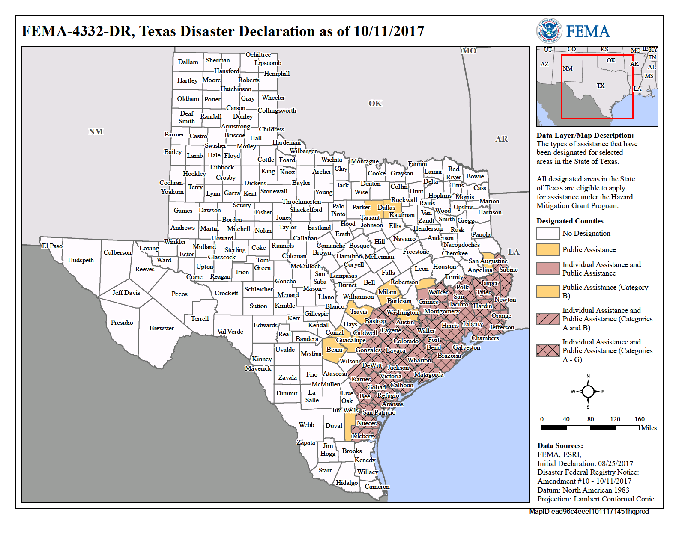

Slide 3


Slide 4


Slide 5


Slide 6


Slide 7


Slide 8


Slide 9


Slide 10


Slide 11


Slide 12


Slide 13


Slide 14
Joshua Owens
Senior Planner
Joshua.Owens@h-gac.com
832.681.2613

