Slide 1
Interviewing Tips and How to Stay Out of Trouble
Local Government Seminar
January 31, 2019
Presented by:
Eileen C. Begle
Senior Assistant County Attorney
Office of Harris County Attorney

Slide 2

Interviewing Tips
Past behavior is the best indicator of future behavior.

Slide 3

Interviewing Tips
We hire people for aptitude and we (almost always) fire them for attitude.

Slide 4
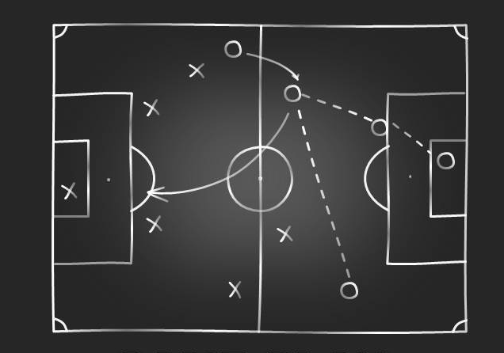
Game Plan
Résumés
Interview Do’s
and Don’ts
Behavior Based Interviewing

Slide 5

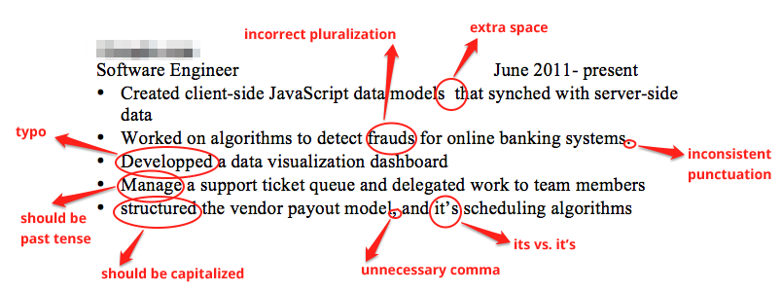
Deciding WHO to Interview
Résumés Speak Volumes
Unprofessional resumes
Lots of errors

Slide 6


Deciding WHO to Interview
Résumés Speak Volumes
Employment gaps
Job hoppers

Slide 7
Deciding WHO to Interview
Résumés Speak Volumes
Unprofessional resumes
Lots of errors
Areas to Explore
Employment gaps
Job hoppers
Legally_blonde@gmail.com

Slide 8

Legal Review (P. 3 and Attachment)
Can I ask that question?
What do you REALLY need to know?

Slide 9

Establishing Rapport
Without Violating the Law (P. 4)
How was the drive?
Did you have problems parking?
Is it raining?

Slide 10

Did You HAVE to Go There? (P. 5)
Responding well to those awkward questions.

Slide 11

Job Components (P. 6)
Competency
Commitment
Compatibility

Slide 12

Job Components
Competency
Knowledge, skills, certificates, and abilities to do the job well

Slide 13

Job Components
Competency
High school
diploma
Type 45 wpm
TDL or CDL
Customer service

Slide 14

Job Components
Competency
Supervisory
experience
Meet deadlines
Problem-solving

Slide 15

Job Components
Commitment
Personal standards and motivation needed to be successful

Slide 16
Job Components
Commitment
Self-motivated
Self-aware
Open to change

Slide 17

Job Components
Compatibility
Values and working styles needed to fit successfully in your group

Slide 18
Job Components
Compatibility
Values public
service
Works well with
others generally
Fits in with our team
specifically

Slide 19
Basic Premise

Slide 20

Interview Questions
Compatibility
Customer service
“Tell me about a time you had a problem with a customer and what you did to resolve it.”

Slide 21


Getting More (P. 7)

Slide 22

Interview Questions
Competency
Meets deadlines
“Tell me your process for ensuring you meet deadlines.”

Slide 23

Interview Questions
Commitment
Self-motivated
“Give me an example of when you initiated a project or went above and beyond the call of duty without being asked.”

Slide 24

Interview Questions
“One time my boss asked me to stay about 15 minutes late.”

Slide 25

Interview Questions
Commitment
Self-motivated
“What do you think is a good reason to miss work?”
Notes:
With all of that out of my system, here are my goals. If you want a treatise on ADA or FMLA, you have it. It’s in the paper..
And, who knows, maybe one of us will learn something and have some fun along the way

Slide 26

Interview Questions
Compatibility
Your work space will be in the copy room. It can get loud in there sometimes.

Slide 27
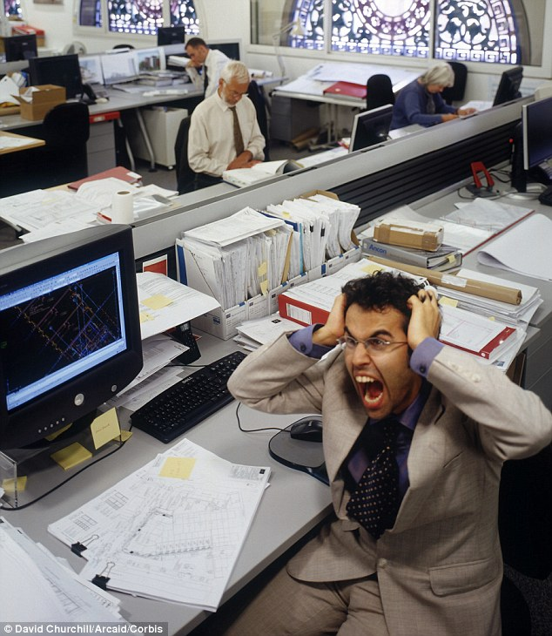
Interview Questions
Compatibility
“Describe the strategies you’ve used to stay focused in a loud or chaotic environment.”

Slide 28

Local Government Seminar
January 31, 2019

