Slide 1
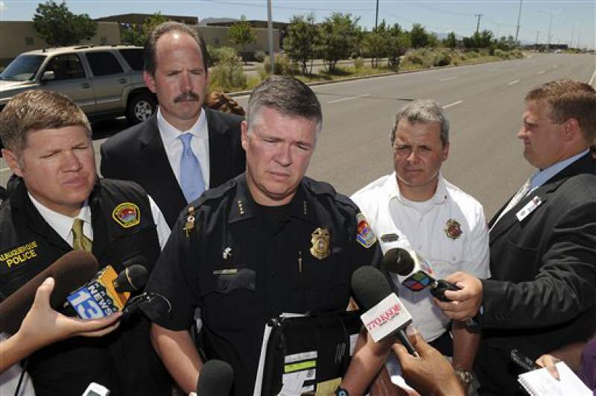
Managing the Message
Organizations and/or their CEO’s
can Live or Die based on their
Ability to Communicate Effectively

Slide 2
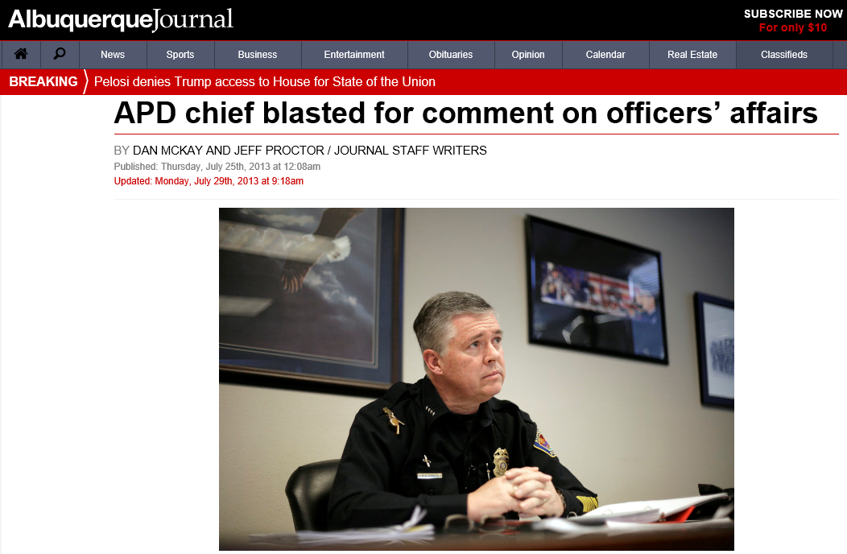
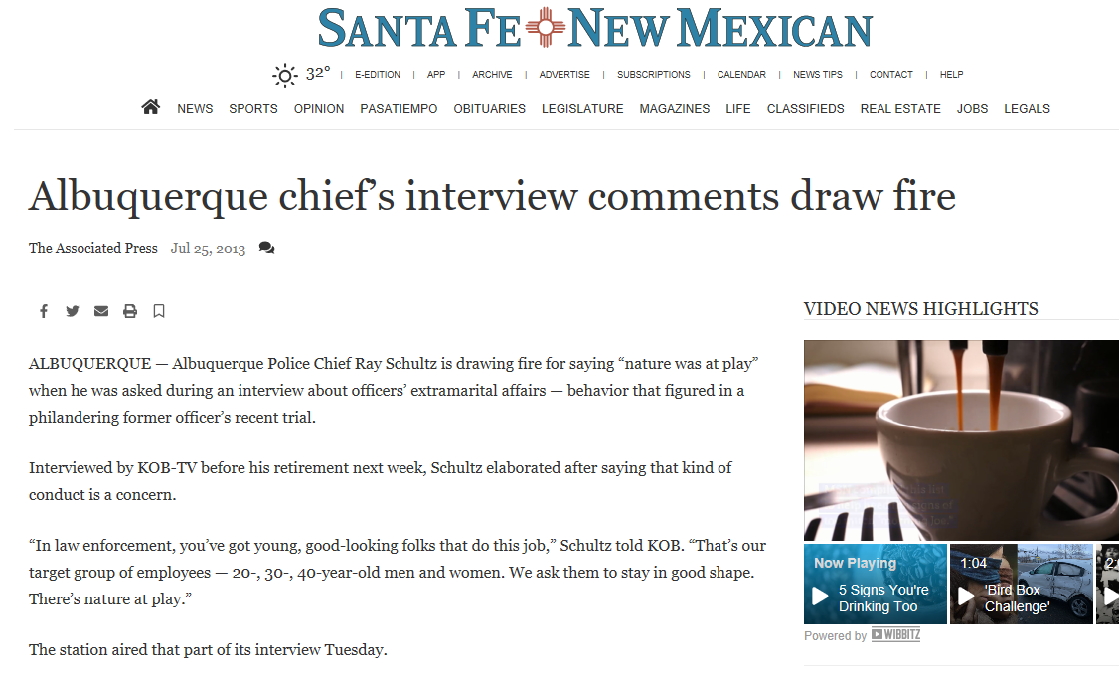
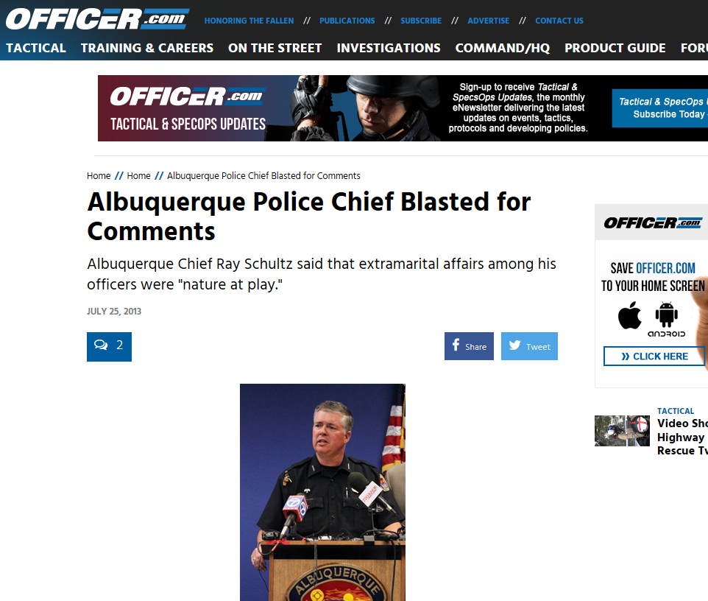
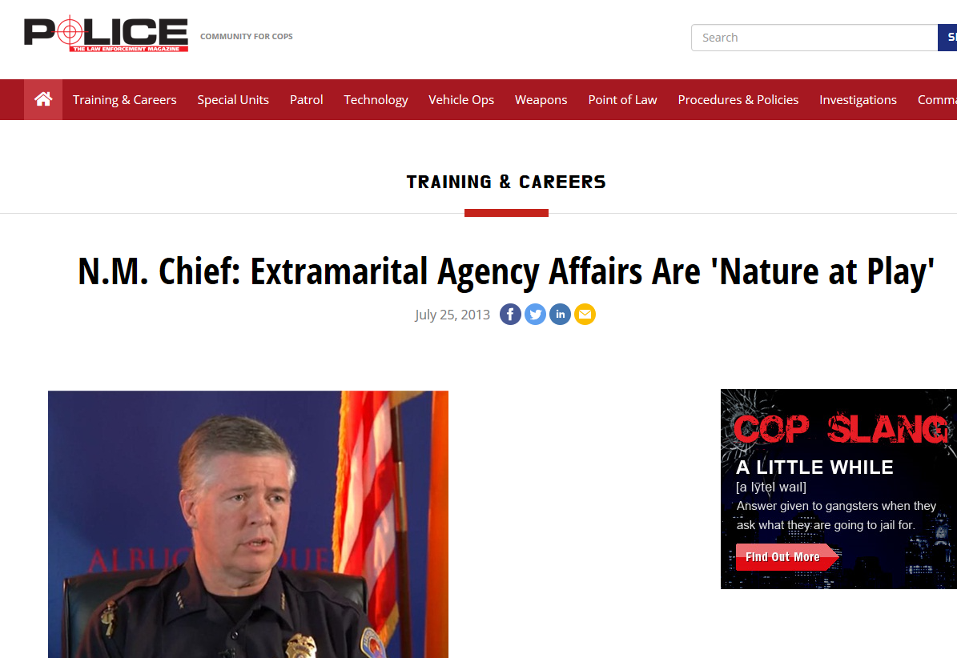
Communication Faux Pas = Battle Scars

Slide 3





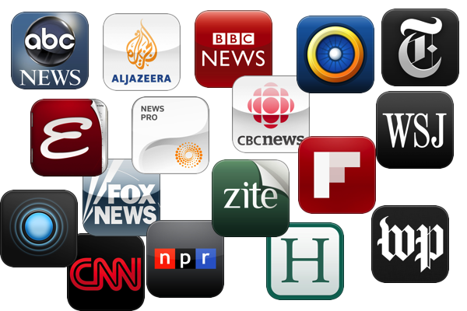






Slide 4

3.6 Million Apps in Google Play
100,000 in the Apple Store
248.68 Million Smartphone Users in the USA (2019)*
Total App Downloads 197 Billion (2017)
Most Popular APP – Facebook – 81% of all Users
Most Popular with Millennials – Amazon 35%
Average Time Spent on Digital Media –
2.3 Hours PER DAY
Notes:
According to Stastica

Slide 5

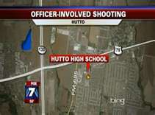
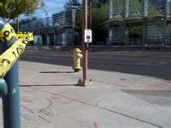
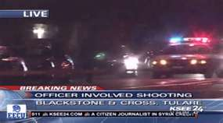

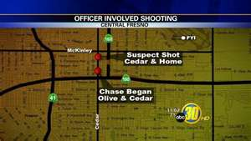



Slide 6

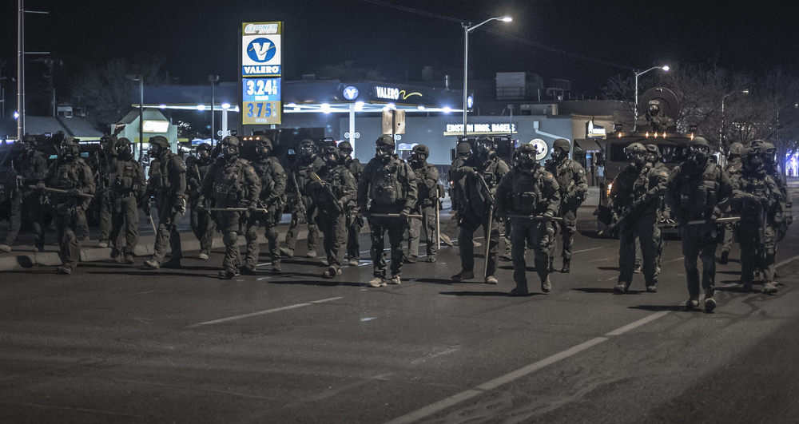
One Tweet can start an a Nationwide Frenzy
Or Worse

Slide 7
Preemptive Communications
Eliminate the “Gotcha” Effect
Proactive
Build a Relationship
Personality
Reputation

Slide 8
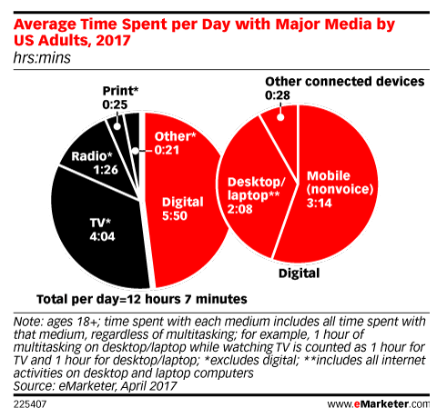
Target Your Audience
Notes:
49% of people under age 49 get their news ON-LINE This is a changing Demographic

Slide 9
How to Effectively Communicate in our Digital World
Control the Message (Don’t let it be hijacked)
Keep it Short – Clear – Interesting
Get to the Point ASAP
800 - 1200 words Max for a written message. 1200 only if it is interesting.
VLINC 800 words + Crime Report
Use Multi-Platforms
Written, Oral, Digital. You must be Dynamic
“Pictures are worth a Thousand Words”
Encourage Feedback/Participation – Do not Preach
Transparency – Strike first with Bad News

Slide 10
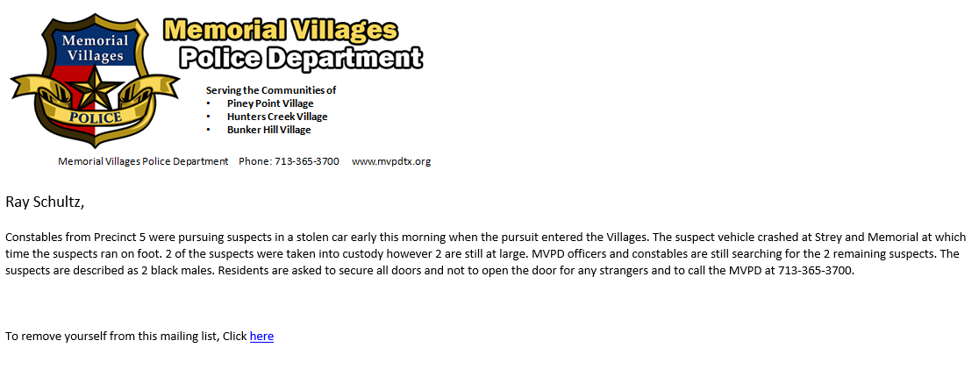
Control the Message

Slide 11
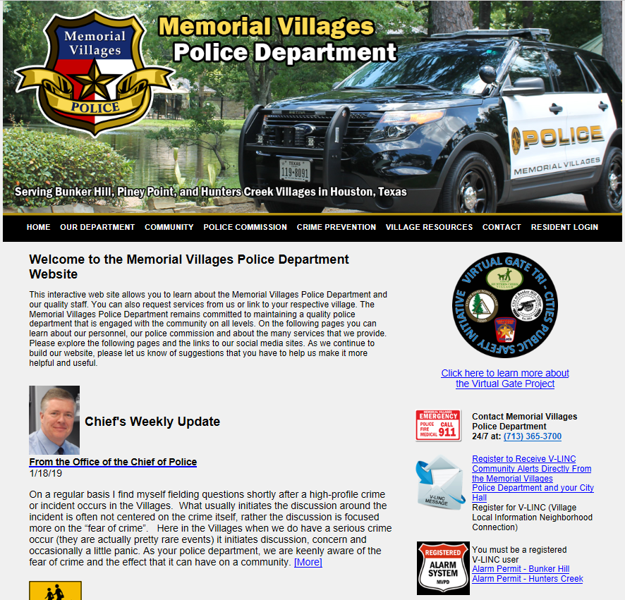

Slide 12
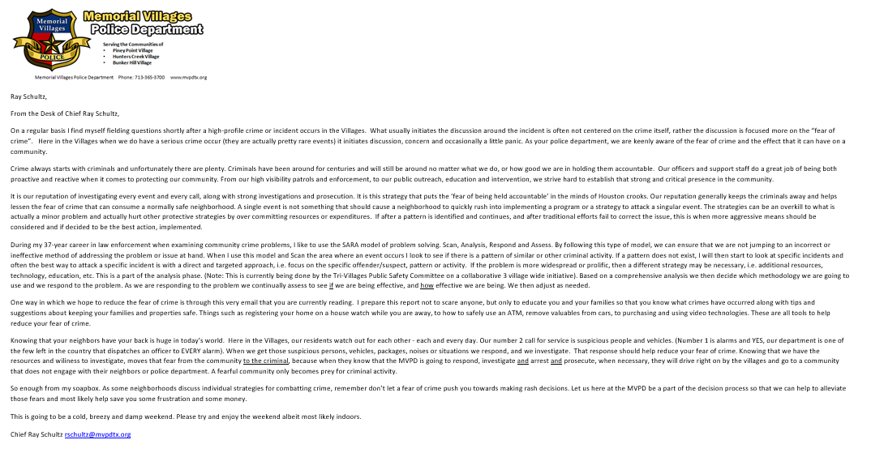
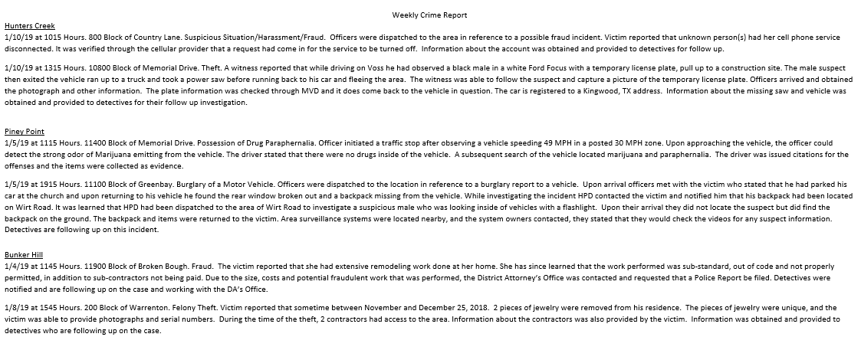

Slide 13

Don’t let your Messaging be Hijacked

Slide 14


Slide 15

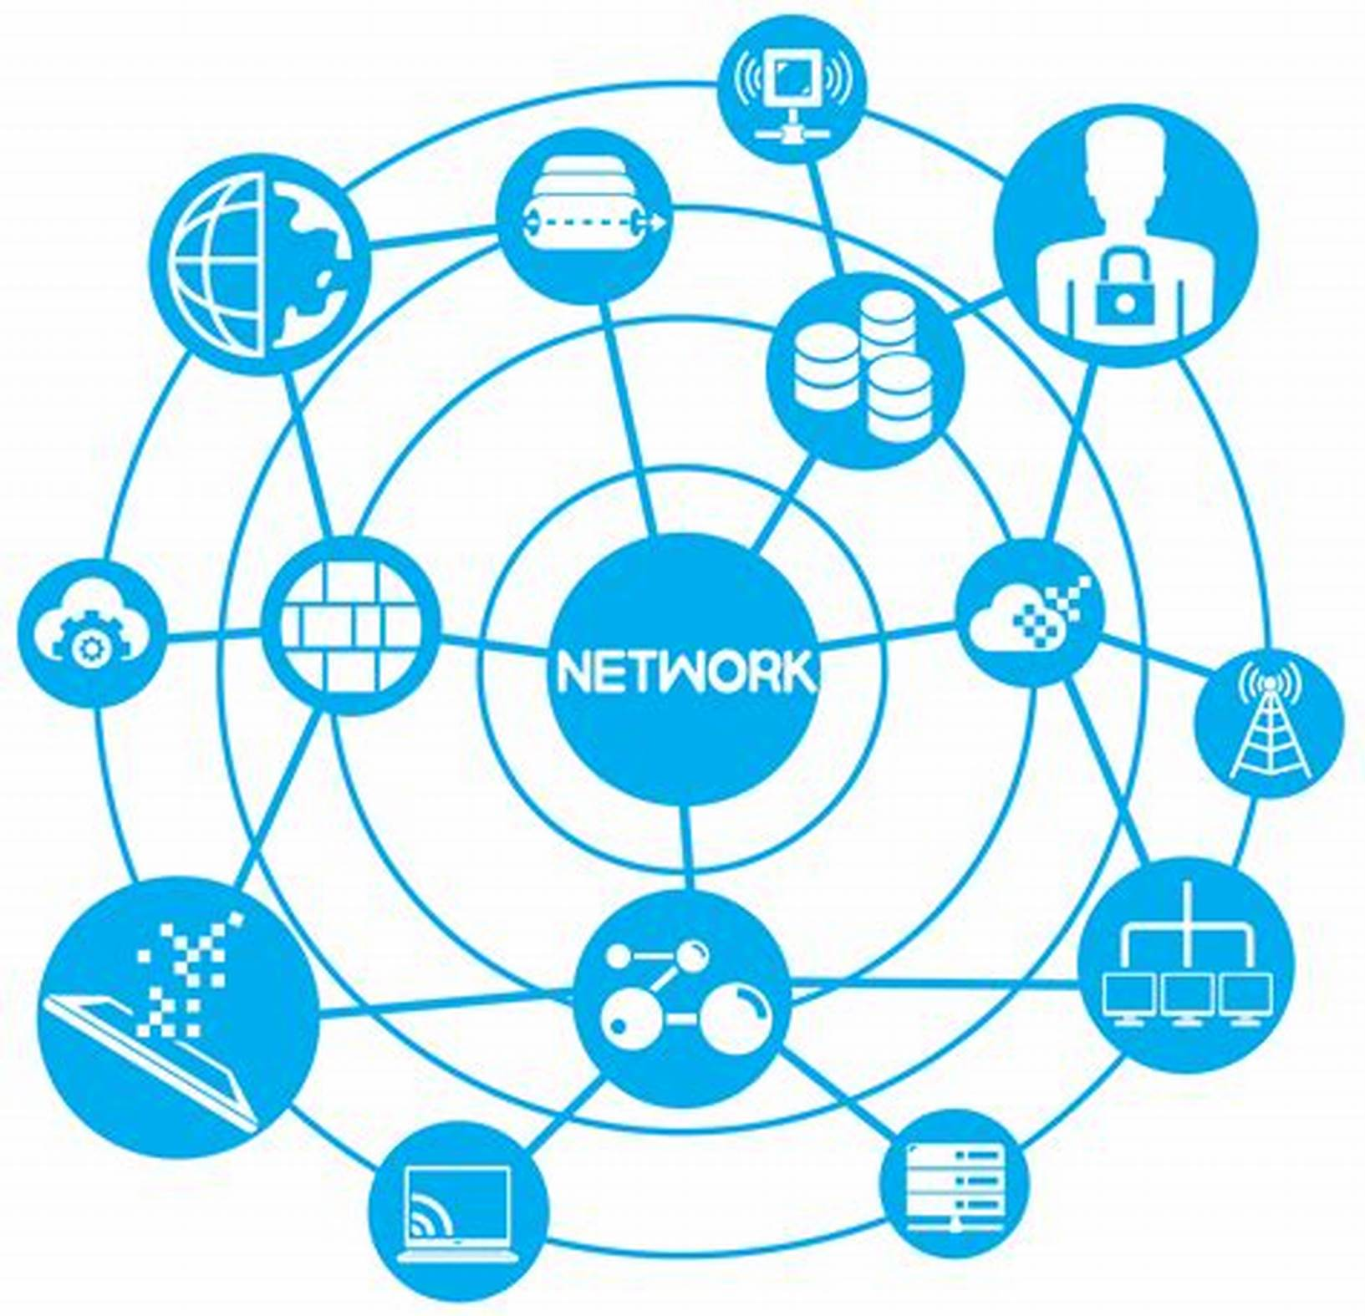
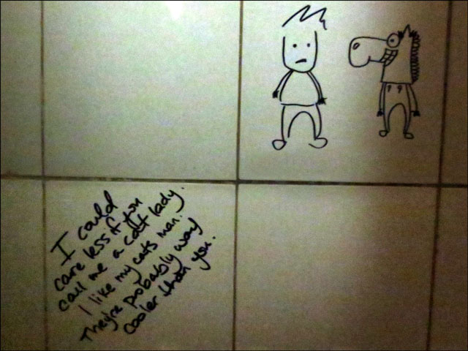
Before the Blog
We had Bathroom Walls

Slide 16
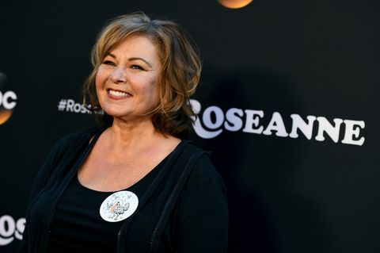
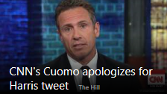
Reactive Communications
“Stop the Bleeding”
Remember
Bad Press…. If you survive
will make you Stronger

Slide 17
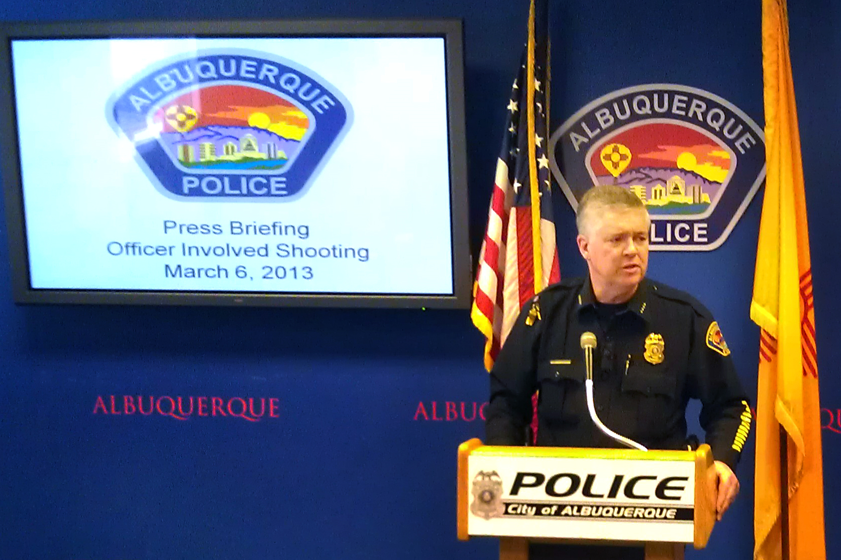
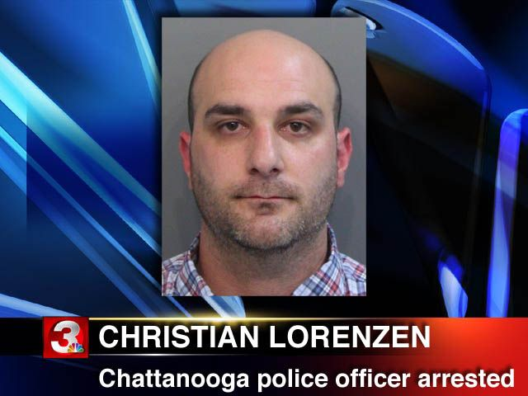
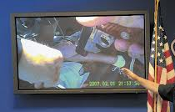
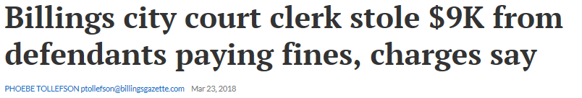
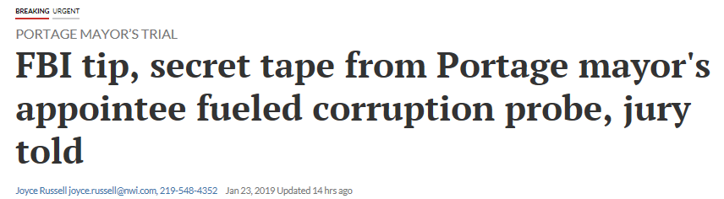
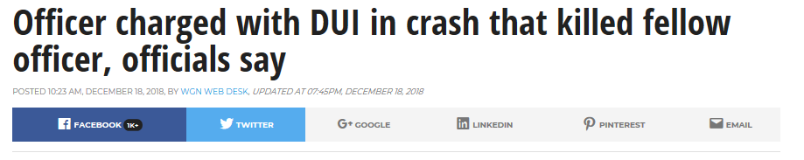
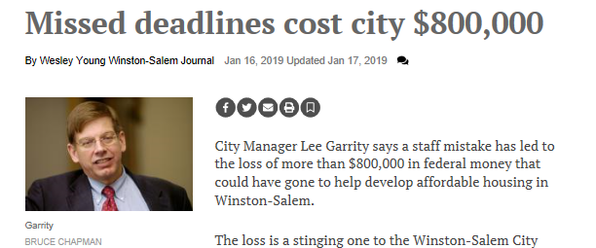

Slide 18
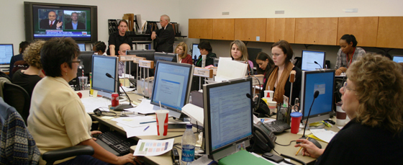
Effective Communications
Requires a Team Effort

Slide 19

Social Media Monitoring

Slide 20
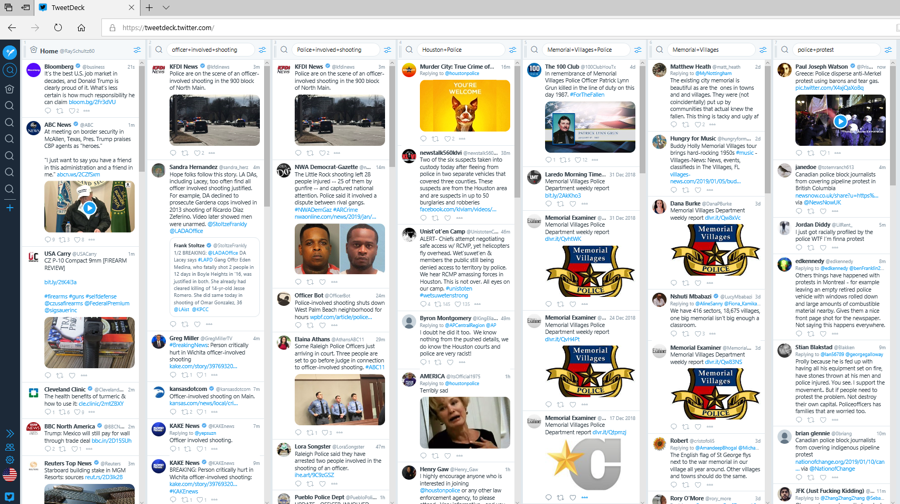

Slide 21
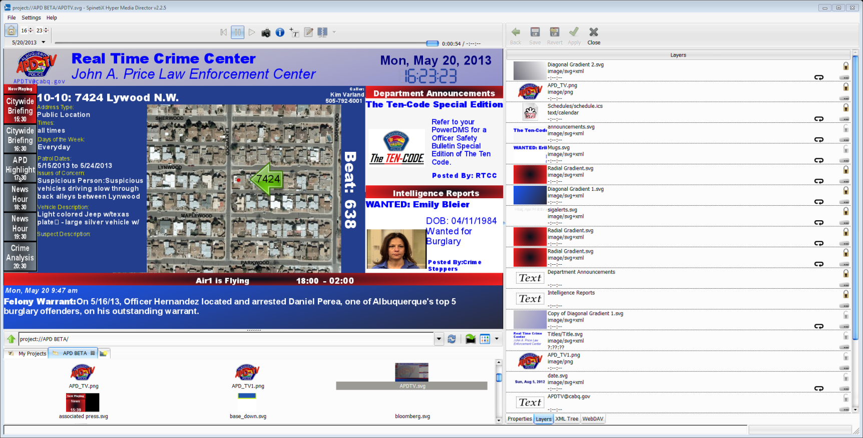



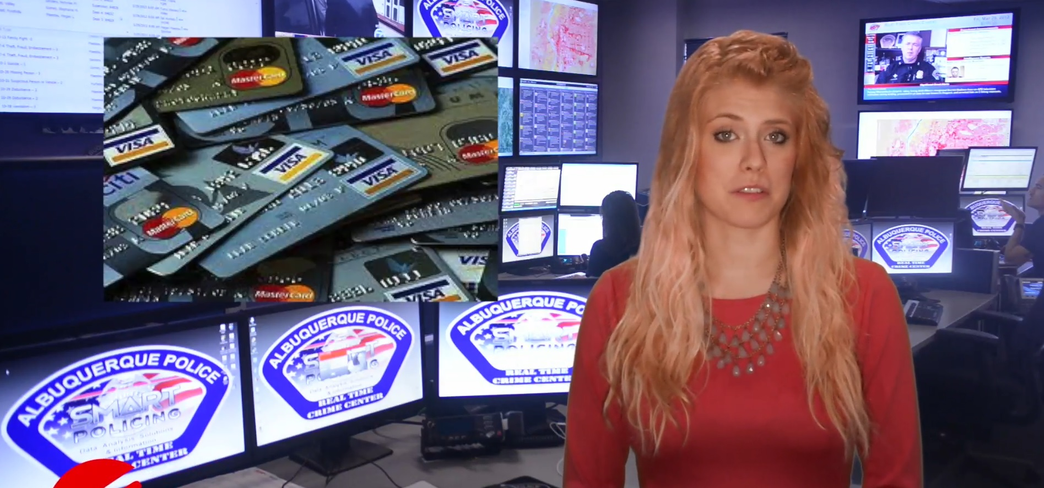
Cut Out the Middleman

Slide 22
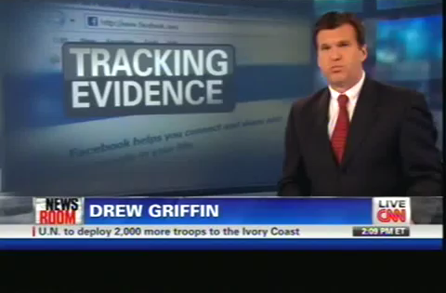
6 Minutes on CNN

Slide 23
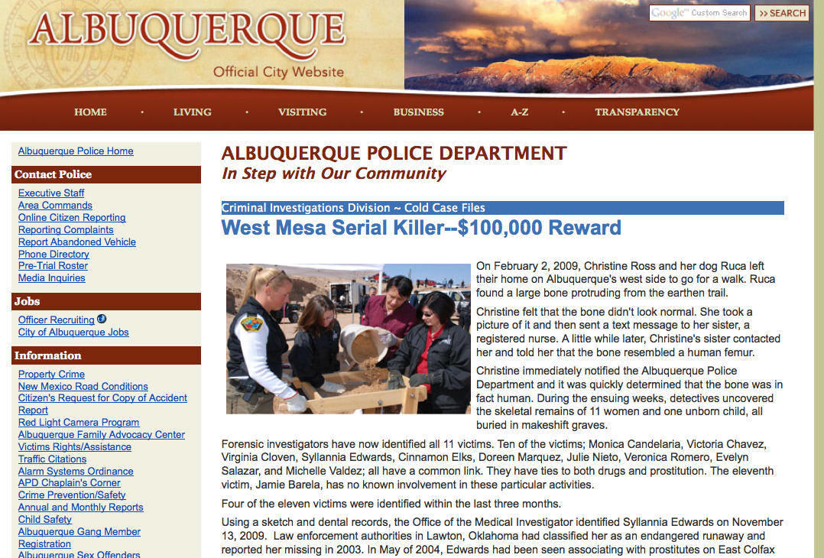

Slide 24
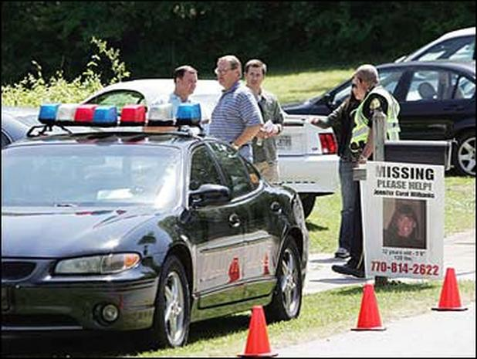
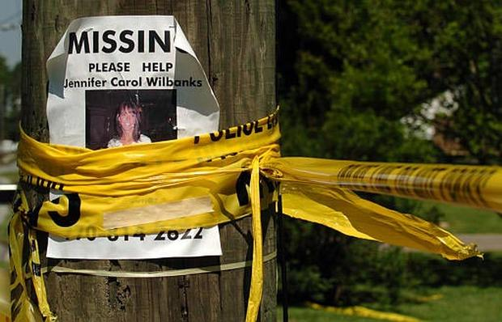
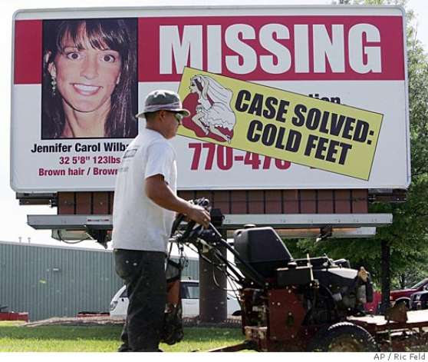

Slide 25

Use Positive Media Experiences to your Advantage

Slide 26


Make sure you are sending the Correct message

Slide 27
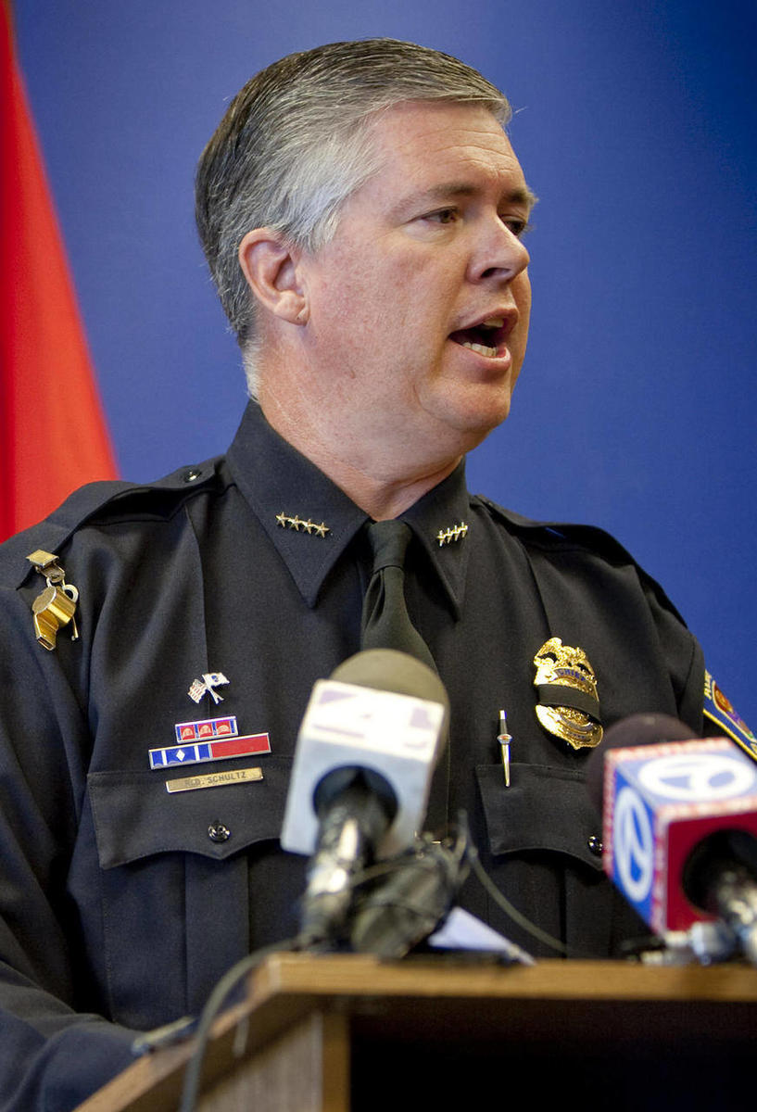
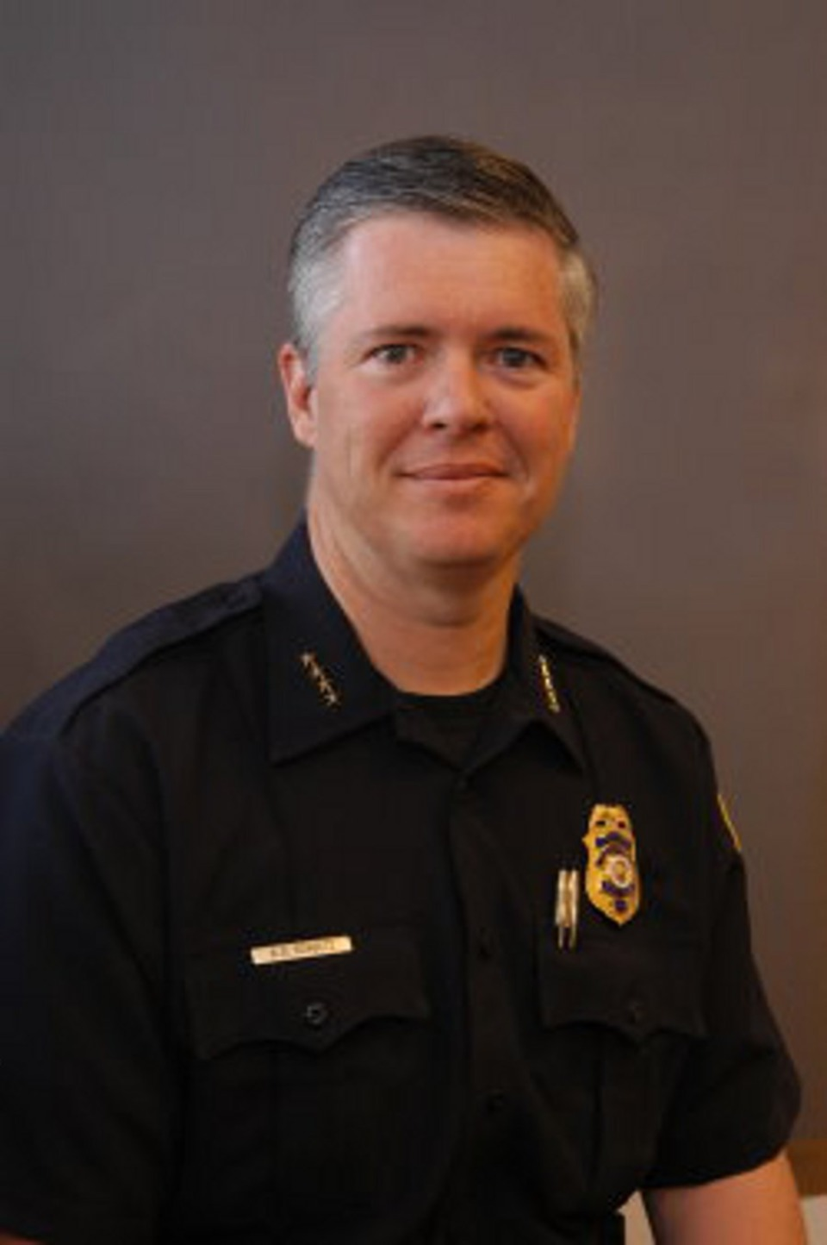
Questions ?
28
0
Ray Schultz
rschultz@mvpdtx.org
1-713-365-3700

