Slide 1
Records Retention and Its Effects on Discovery
Local Government Seminar
January 19, 2017
Andrea Chan, Attorney

Slide 2
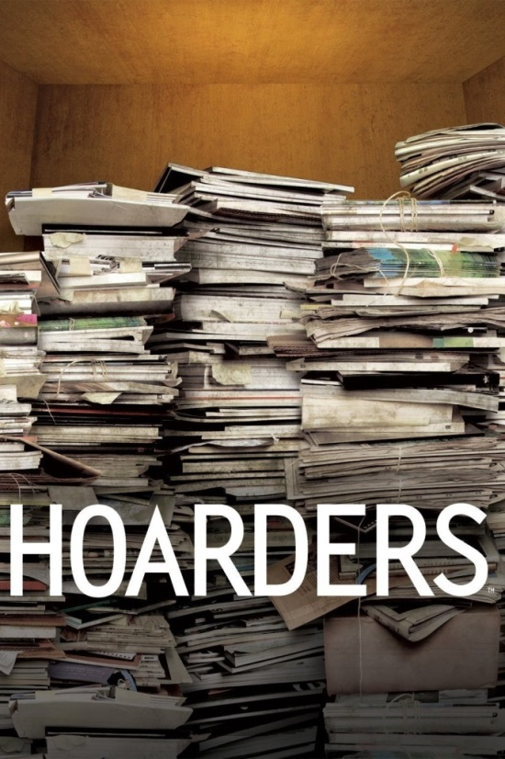

Record Management & Retention
Rule 1.12-Organization as Client

Slide 3
What is data retention?
Records Management
  Combination of policy, process, workflow
  Function of records management
Discovery and eDiscovery
  Reaction to litigation or investigation
  Process of data retention

Slide 4
What is a record?
“Local government record” means any document, paper, letter, book, map, photograph, sound or video recording, microfilm, magnetic tape, electronic medium, or other information recording medium
Tex. Loc. Gov't Code Ann. § 201.003

Slide 5
What is a NOT a record?
Extra identical copies
Documents created for convenience
Blank forms
Stocks of publications
Materials acquired for reference/display
Copies furnished to the public
Records associated with ADR procedures

Slide 6
What is a document?
Paper
Books
Accounts
Drawings
Graphs
Charts
Tex. R. Civ. P. 192.3
Photographs
Electronic recordings
videotape recordings
Data
Data compilations

Slide 7
Records & Documents: Similarities
A record or document can
Exist in any format
Be created or received
Be open or confidential
Rule 1.05-Confidentiality of Info

Slide 8
E-Records
Records stored electronically
Follow general definition
Require a device to read the data and metadata
May be on personal devices

Slide 9
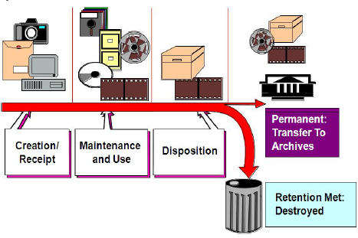
Records Management Cycle
Texas State Library, Introduction to Records Management Local

Slide 10
Records Management Benefits
Protects from unauthorized activity
Complies with the Local Government Records Act of 1989
Authorizes destruction of records
Allows timely response to requests
Rule 3.02-Minimize Delays

Slide 11
Records Management: Disposition
Dispose regularly
Follow disposition policy
Use approved methods
Maintain disposition log
Retain disposition records

Slide 12
E-Records: Special Considerations
Policies and Procedures
Data Maintenance
Storage Media
Security
Destruction

Slide 13
E-records: Email Management Tips
Email = a record
The “Record Copy”
Keep v. Delete
Organize & Classify

Slide 14
Discovery -- Litigation Holds
Litigation Hold Request/Letter
  May come accompany a claim letter
  May come from your own counsel
Suspends approved destruction schedule
Applies to all departments and employees that might have relevant documents

Slide 15
Discovery – Gathering Documents
Identify everyone who may have documents/records
Rule 3.02-Burdens/Delays
Gather anything which might be remotely related
Rule 2.01-Advisor

Slide 16
Discovery – Gathering Documents
Be ready to provide the disposition log for destroyed documents
Rule 3.04-Fairness
Update with changes or new information/documents/records
Rule 3.03-Candor

Slide 17
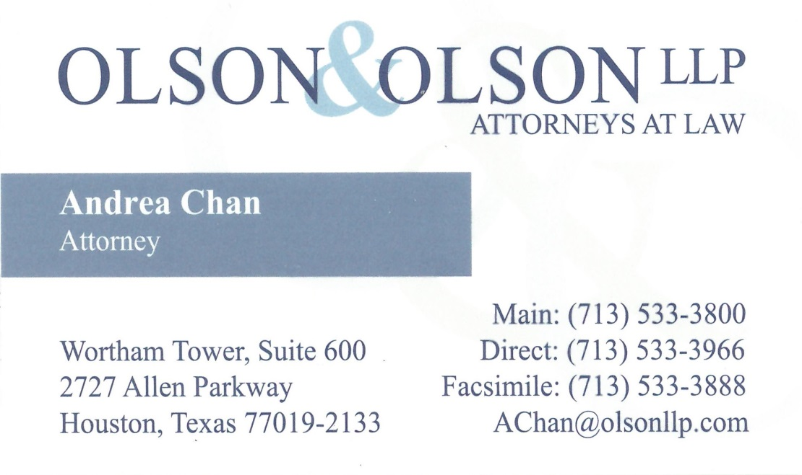
Contact

