Slide 1
Getting the Most from Your Appraisal District
By Sands Stiefer

Slide 2
About CAD’s generally
Created by legislature in 1979
Responsible for property tax appraisals, tax ownership records, and exemption administration
Previously each taxing jurisdiction could do its own appraisals

Slide 3
One CAD for each county, same boundaries as the county
Governed by board of directors
Chief appraiser is the chief administrator
Appraisal review board – citizen board that hears protests (disputes over value)

Slide 4
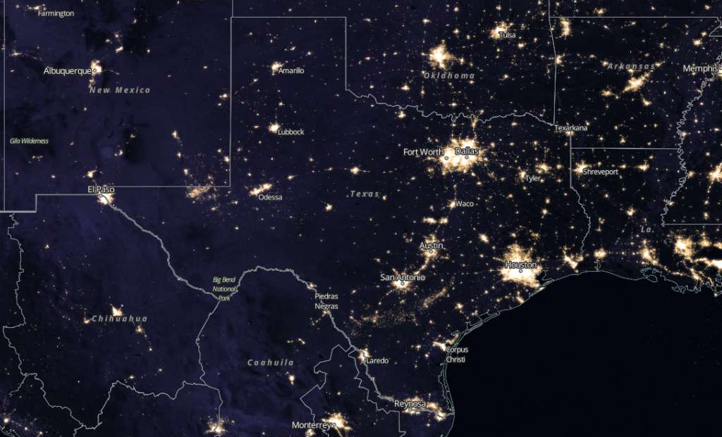
Local CADs have a huge task

Slide 5
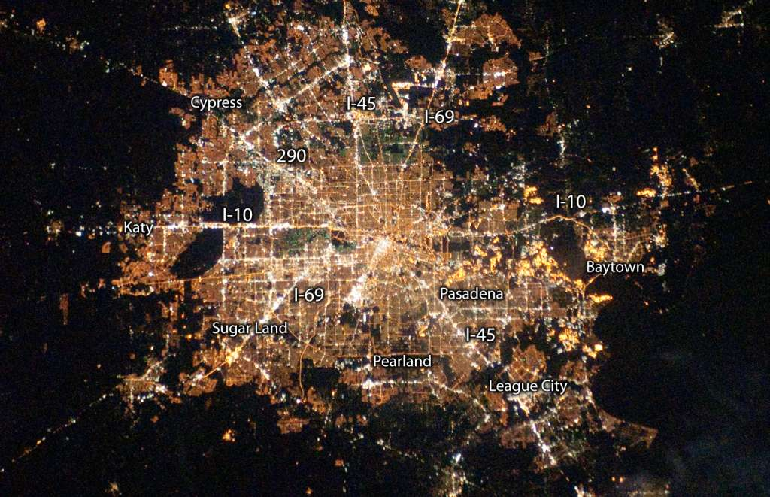

Slide 6
The counties in the SMSA, Brazoria, Chambers, Fort Bend, Galveston, Harris, Liberty, Waller, and Montgomery…
Have 19% of the state’s 19M parcels, but
24% of the business personal property value
29% of the commercial real property value
36% of the industrial personal property value
39% of the industrial real property value

Slide 7


Individual vs. Mass Appraisal

Slide 8
Here are some of the interesting appraisal challenges that presents
Two largest cities in US without zoning (Houston & Pasadena)
Two major ports
Two international airports
Largest petrochemical complex in the US
Even tiny Waller had $1/2B industrial property on its roll in 2017

Slide 9
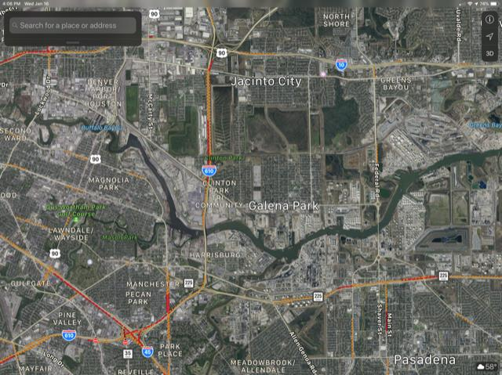
Complexity example

Slide 10
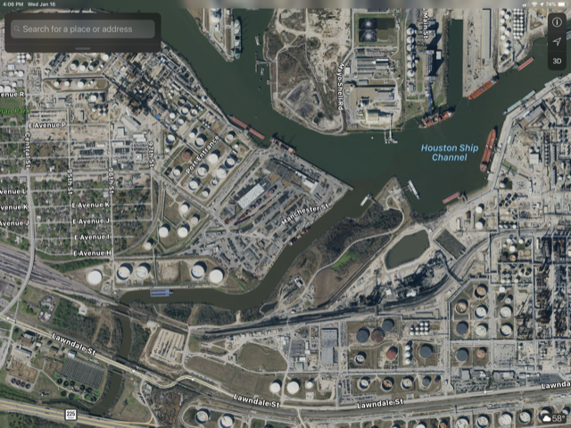
Complexity example

Slide 11
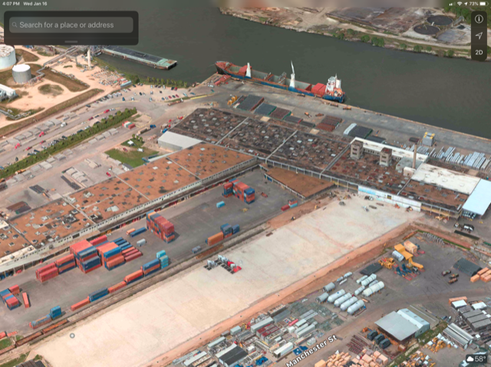
Complexity example

Slide 12
Complexity example
What’s in the tanks?
Where’s the ship been?
Who owns the trucks?
What’s in the warehouse?
Leased or owned?

Slide 13
Property taxes operate on an annual cycle
January – April CADs Develop values
May – July ARB process
August – October Units set rates and send bills
November – January Tax collection process

Slide 14
Cities have a voice in CAD governance
Cities participate in the election of CAD directors.
Right to nominate candidates
Vote in proportion to levy (varies with CAD)
Right to recall members they voted for
Some CADs have specific city representatives

Slide 15
Cities have a voice in CAD spending
Cities pay a portion of the CAD budget
Equivalent to the ratio of the city levy to all taxes levied in the CAD
Budget process runs from June – September
Input through directors, chief appraiser, public hearings

Slide 16
Cities have a voice in vetoing bad decisions
Any CAD budget or other decision of CAD board can be vetoed by a majority of the total number of county, cities, school districts, and junior college districts in the county.

Slide 17
What CAD directors can (and can’t do)
They do | They can’t do
Employ chief appraiser | Communicate with chief appraiser about appraisals
Appoint ARB chair (and smaller counties appoint members) | Influence decisions by the ARB
Adopt CAD budget | Let a city off the budget hook
Adopt general policies | Make employment decisions other than chief appraiser
Adopt reappraisal plan | Participate in individual appraisals

Slide 18
Chief Appraiser
Chief administrator of the CAD
Employs and compensates staff
Proposes the CAD budget
Performs a variety of other actions, depending on the size and complexity of the district
Several new or about to be new in jobs

Slide 19
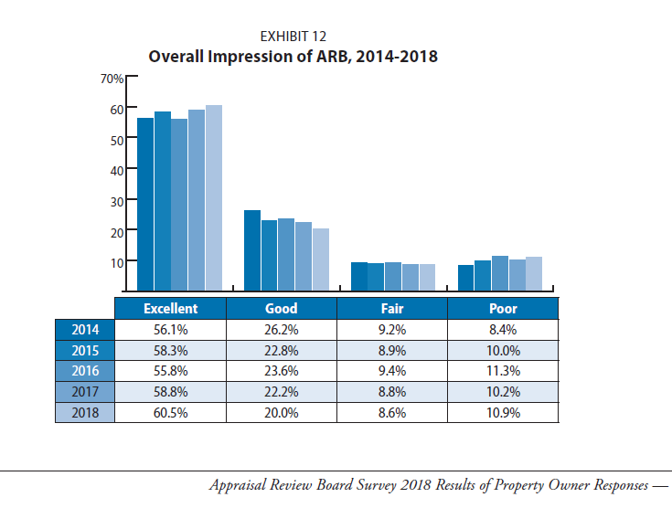
ARB
Citizen body that hears protests about appraisals

Slide 20
Tax Assessors and CADs
Cities can have their own tax assessor or contract with another jurisdiction to handle that for them.
Many of the CAD’s statutory communications take place with the assessor.
CADs assume the assessor tells you.

Slide 21
Cities have a voice in setting tax amounts
Tax amount = Tax Rate (set by the city) x Taxable Value (set by the CAD)
In theory, as values of existing properties increase, the tax rate can decrease to offset value changes.
Cities also have the power to adopt and change a variety of exemptions

Slide 22
Optional exemptions
Residence homestead (up to 20%)
Over-65 homestead (at least $3,000, no max)
Tax abatement (up to 10 year for new property value)
Freeport and goods in transit (benefit those who make and ship goods)
Historic sites

Slide 23
Can I get budget help from the CAD?
not later than April 30, the chief appraiser shall prepare and certify to the assessor for each county, municipality, and school district participating in the appraisal district an estimate of the taxable value of property in that taxing unit. The chief appraiser shall assist each county, municipality, and school district in determining values of property in that taxing unit for the taxing unit's budgetary purposes.
Tex. Tax Code Ann. § 26.01 (West)

Slide 24
Budget stuff
Preliminary estimate of value April 30
Certified appraisal roll ~July 25
CADs rely heavily on data that comes in between January 1 and the date they send notices.
Check with your CAD about one on ones, briefings, etc.

Slide 25
Once I have my bills out everything’s OK, right?
A variety of things can change the roll
Unresolved protests
Litigation settlements
Corrections and exemptions from prior years
Finance folks need to work closely with the CAD to plan for these.

Slide 26
Cities can help the CADs
Sharing permit records
Prompt notice of annexations, city purchases
Joint efforts
  Disaster estimation
  GIS and property images
  Emergency service sharing
Help us in the legislature!

Slide 27
Thanks!

