Slide 1
Alternative Dispute Resolution
Local Government Seminar
January 31, 2019
Emily Brown, Attorney, Certified Mediator

Slide 2

What is Alternative Dispute Resolution (ADR)?
ADR refers to the various methods by which a third party neutral assists in settlement/resolution of a conflict
Notes:
TRADITIONAL MEANS OF RESOLVING DISPUTES
Fight, force, or coercion
Usually considered as the win-lose approach
Survival instinct leads to the use of this alternative
Flight or avoidance
Avoidance where the dispute is not of great significance to one or all of the parties, or the dispute is of low priority.
Likely to occur where the disputing parties will have no future relationship.
Unresolved and internalized conflicts usually linger
Ordinarily it intensifies
Particularly true where there is an ongoing relationship between the parties
Unresolved disputes are likely to recur or simply manifest in another manner
ADR highlights the theory of compromise
Often say no one leaves mediation happy

Slide 3
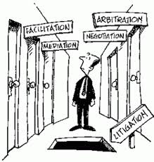
Why Participate in ADR?
Litigation is:
  Time consuming
  Expensive
  Risky
Notes:
GOALS: Dispute Resolution Outcomes sought by parties
To reconcile underlying interests
Interest based dispute resolution is also seen as collaboration, the most integrative method of dispute resolution
The most productive conflict handling behavior
The most effective system of dispute resolution
To determine who is right
To conclude who is more powerful

Slide 4


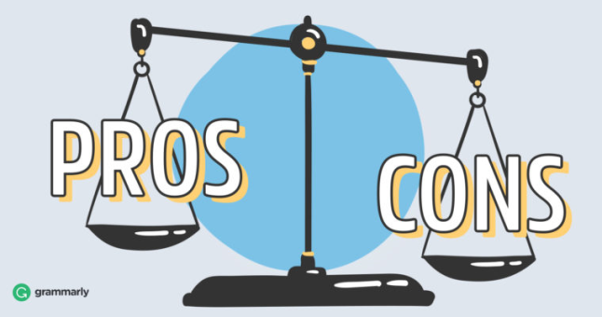
ADR Devices
The ADR Process is defined by what the third party neutral does to assist in settlement
Three types:
  Adjudicative – Arbitration
  Evaluative – Non-binding assessment of case merits
  Facilitative – Mediation

Slide 5
ADR Process Options
Higher Party Control of Outcome
Less Party Control of Outcome
Evaluative Processes – Peer Evaluation, Summary Jury Trial, Judicial Evaluation, Expert Evaluation
Facilitative Processes- Mediation
Adjudicative Processes - Arbitration

Slide 6
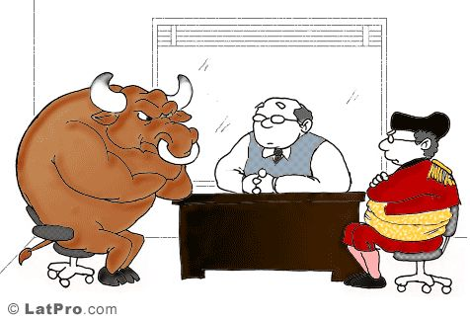
Adjudicative
    Neutral adjudicates
    ADR procedures most similar to formal court proceedings
    Includes Arbitration, private adjudication, or private judging
    May be binding, non-binding, or advisory
Notes:
Arbitration
Usually used before suit is filed, during discovery, and as a substitute for trial or appeal.
Background
Typically a sole arbitrator or panel of three. If panel of three, each party chooses one and those two chose the third
Arbitration is most effective where the parties cannot agree on the facts or where the dispute is purely monetary; also highly complex or technical cases.
Adversarial presentation with arbitrator being the sole judge who renders a binding award;
More formal than most ADR devices;
Binding if parties have contracted for it to be;
Very limited, usually statutory rights of appeal;
Mandatory court arbitration are advisory in nature;
Variables:
Determination of the rules of procedure;
Appropriate time for the use of arbitration;
Amount of discovery;
Whether arbitrator should make a naked award or explain it;
Whether the parties want the arbitrator to make findings of fact and conclusions of law;
Scope of appealability;
Background of the arbitrators.
High-Low—arbitrator chooses award as long as between boundaries
Prior to the arbitration hearing, the parties establish a bounded range for the award. If the arbitrator’s award falls within that range, then the arbitrator’s award becomes binding on the parties; if the arbitrator’s award is outside the range, then the award is adjusted to the appropriate high or low boundary
Arbitrator does not know amount agreed upon.
Arbitrator determines award within high/low boundary.
Final Offer Arbitration / Baseball Arbitration—party chooses award
In this process, each party submits a proposed monetary award to the arbitrator, who chooses one of the proposed awards based on the merits of the presented case. The arbitrator does not modify the proposed award of the prevailing party. This technique limits the arbitrator’s discretion and encourages parties to propose reasonable awards.
Arbitrator knows what final offers are.
Night Baseball Arbitration—party chooses award, but arbitrator does not know choices.
As with baseball arbitration, each party submits a proposed monetary award to the arbitrator. However, the arbitrator does not know the contents of the proposed awards. At the close of the hearing, the arbitrator issues a non-binding award, and the proposed award that is closest to the arbitrator’s award becomes binding on the parties (award to the party whose proposal is closest to that of the arbitrator).
Arbitrator does not know amounts agreed upon.
Private / Special judging: the parties hire a former judge to hear the case and render a decision. Originated in California. aka rent-a-judge, referee;
Resembles traditional litigation; same power as a judge;
Private reporter and right of appeal;
Most useful in cases where a dispute of both law and fact is the impediment to settlement;
Neutral Fact-finding: the neutral third party, after gathering information from all parties, makes a determination of the facts.
Binding or advisory; recommendations are not final.
Used in public sector labor relations disputes

Slide 7
Evaluative
Primary purpose: provide an objective, non-binding, confidential, evaluation of the merits of the case, which may be used by the lawyers and clients in further settlement negotiations
Four Types:
  Peer Evaluation: Moderated Settlement Conference
  Lay Evaluation – The Summary Jury Trial
  Judicial Evaluation
  Specialist or Expert Evaluation
Notes:
Peer evaluation: The Moderated Settlement Conference (MSC) is a process designed in Texas, and uses a panel of three neutral, experienced attorneys who listen to a presentation consisting of both factual and legal argument by counsel for each party. Panel then renders an advisory, confidential evaluation of the strengths and weaknesses of the case and often provides a range of settlement. Evaluation is non-binding as is to be used as a basis for further settlement negotiations. (MSC = “Michigan Mediation”)
Neutral evaluation or neutral case evaluation: one attorney is the sole evaluator.
Early Neutral Evaluation (ENE) - court hand selected the attorney;
Initial goal is to force the parties to confront their case and each other, to identify the actual matters in dispute, to develop an efficient discovery process and to obtain an assessment of the case;
Neutral makes introductory remarks followed by parties’ remarks;
Neutral questions the participants in an attempt to narrow the issues;
Lay evaluation – the summary jury trial (SJT): The attorneys present an abbreviated version of their evidence to an advisory jury usually selected from the regular jury pool. Used when the parties or the court feel that a preview of what a jury might do would be helpful to better assess the case for settlement purposes;
Judicial evaluation: judge will merely point out to the lawyers and litigants the strengths and weaknesses of the case (in contrast to private judging where the judge actually decides the case). May also simply involve a pre-trial conference.
Specialist or expert evaluation: Provides an independent, neutral, expert evaluation of such a technical issue, a resolution may be achieved in a case which would otherwise take months to try. As long as all parties agree to the selection of the neutral expert, the results are generally accepted as definitive. Used in specialized areas like construction, medicine.

Slide 8
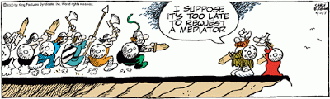
Facilitative
Mediation
      The third party neutral provides assistance to the parties so that they may reach an acceptable agreement
      Combined Processes and Hybrids
Notes:
Mediator does not render a decision or an evaluation. A third party neutral acts as a facilitator to assist in resolving a dispute between two or more parties.
Least adversarial approach and encourages the parties to communicate directly.
Role of the Mediator includes:
Facilitating communication between the parties,
assisting in identifying the real issues of the dispute and the interests of the parties and
generating options for settlement.
The parties arrive at their own agreement;
Family law area may have an attorney and a therapist as mediators;
May be used at the appellate level;
Valuable where the parties want to maintain the relationship or where the underlying issues need to be explored.
Combined Processes and Hybrids
Mini-trial: used primarily by large corporate litigation and a hybrid of negotiation, mediation and case evaluation; Preservation of an existing business relationship; Need high level corporate decision-maker; Sides meet with an expert, third party neutral advisor to present their best case; Followed by direct negotiations by top level executives; If unsuccessful, the third party may render a non-binding opinion or evaluation
Jury-determined settlement (JDS): blend of summary jury trial and arbitration. Jury is empanelled and makes a binding verdict
Med-Arb: combines mediation and arbitration process (TX). Most common combined process. The parties can agree ahead of time that the mediator will become the arbitrator for the small things that were not settled in mediation.

Slide 9
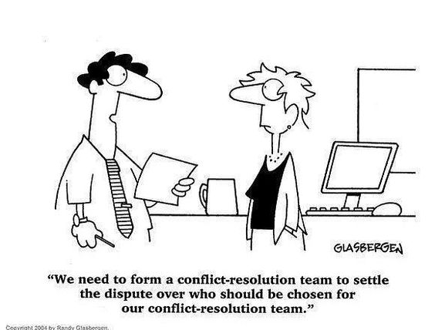
Specialized Applications of Mediation
Agricultural Disputes
Collaborative Law
Schools and Universities
Religious Institutions
Family Law
Employment and Labor
Public Policy
LGBT Issues
Health Care
Transactional Matters
Sports Law
Notes:
Agricultural Disputes
Disputes between farmers and lenders
Mediation clause; Agricultural Credit Act of 1987 mandated mediation;
Differs from traditional mediation in that the rules surrounding the programs presume an inequity of power;
Farmer must be provided legal information, financial advice prior to mediation; not provided by mediator;
Mediator’s play a more active role;
Migrant farm worker and grower.
Collaborative law
Collaborative law – a contract to work out disagreement; approved in TX for family law disputes.
Collaborative law being pushed hard in IP area.
Collaborative law fast growing area.
Schools and Universities
Peer mediation aka school based conflict management;
One of the fastest growing areas;
National Association of Mediation in Education (NAME) now called CREnet (Conflict Resolution Education Network): national clearinghouse for materials re peer mediation;
Where used:
Truancy cases; between departments; between parents and school administration;
Sexual harassment claims; age discrimination;
Religious Institutions
Family law (Divorce and Family)
One of the oldest specialties;
Divorce mediation differs from traditional or generic mediation:
Generic is at one-time intervention that may last a day or an hour
Divorce mediation occurs over weeks or months
Divorce uses co-mediation and sometimes accountants;
Texas: Termination of Parental Rights - funded by the Children’s Justice Act Project
Employment and Labor
Union and collective bargaining;
Postal service, the largest public employer, has a program entitled REDRESS (Resolve Employment Disputes Reach Equitable Solutions Swiftly);
Public Policy Matters
Generally:
Differs from traditional mediation:
Confidentiality
Duty to inform the public of decisions;
The decision-maker is the body politic;
Open meetings
Alternatives aren’t litigation and self-help. They are lobbying and protesting;
Agreements contingent upon governmental approval
Texas: statewide office for public policy disputes
Environmental issues
Mediator should have expertise and rely on the assistance of engineers and other experts
The Federal Sector
Post office mediator; IRS mediator
Civil Justice Reform Act of 1990: required each district court to design a cost and delay reduction plan; it encouraged ADR; majority of plans used ADR;
Alternative Dispute Resolution Act of 1998: mandated the use of ADR by district courts;(later adopted by Texas)
The Administrative Dispute Resolution Act:
Encourages each federal agency to establish a dispute resolution policy
Considers a variety of ADR methods
Procedures for confidentiality
Who’s eligible to serve as neutrals
Negotiated Rulemaking Procedure Act:
Urges federal agencies to use the “reg-neg” process in their rule-making
Reg-Neg (regulatory negotiation or negotiated rule making).
Rule making authority negotiates the passage of the rule with the affected parties prior to enactment of the rule—not confidential.
All interested parties are invited to take part in the initial design of the rule
3P neutral, called a convenor, is responsible for each step in the process
Viewed as a specific form of consensus building.
3 Steps including a determination of:
parties affected by the proposed legislation;
feasibility of use of negotiation;
Notice and meeting;
State and local governments
Ad Valorem Litigation
Texas Water Commission;
City of Austin – downtown revitalization
Criminal context – not done in Harris County (is done in Corpus Christi with some success)
LGBT Matters
Relationship dissolution and family restructuring;
HIV issues and expediency of the litigation;
Health Care Issues
American Arbitration Association, ABA and American Medical Association: Due Process Protocols:
Recommendations which include ADR be used to resolve disputes
Medical negligence and malpractice
Decisions not to resuscitate;
Disputes Involving Attorneys
Criminal Law:
Domestic/co-habitant violence;
VORP (Victim Offender Restitution/Reconciliation Programs) and VOM (Victim Offender Mediation):
Restorative justice;
Transactional Matters
Sports Teams

Slide 10

The Mediation Process
Mediation is facilitated negotiation by which a neutral third party assists disputing parties in reaching a mutually satisfactory resolution
  Key is voluntary resolution
Steps/Stages
  Preliminary arrangements
  Mediator’s introduction
  Opening statements by parties
  (Ventilation)
  Information gathering
  Issue identification
  (Agenda setting)
  (Caucus)
  Option generating
  (Reality testing)
  Bargaining and negotiating
  Agreement
  Closure – must be something the judge will uphold
Notes:
Steps/Stages
Okay, you’re ordered to/agree to attend mediation. What to expect:
Preliminary arrangements (scheduling, location, forms). Encompasses everything that happens prior to the beginning the actual mediation session including: Referral, Getting to the table, Selection of the mediator, The determination of who should attend, Mediator uses to gain information and give information about him and the process;
Mediator’s introduction: goals for mediation plus housekeeping (get parties into comfort zone—describe process, ground rules, objectives, confidentiality); describes process (no pressure, everything confidential, mediator not there to make decision for you); set ground rules; goals and objectives from the mediator may be set out here, usually start with joint caucus (not adversarial meeting).
Opening statements: may include venting; do not interrupt; done by parties and attorneys (they give view); may need to establish time limits if a complex, multi-party case.
Ventilation: very important (if it becomes adversarial, split up into caucus).
Information gathering: mediator engages parties in information gathering; hand in hand with ventilation; mediator should ask open ended questions.
Issue and interest identification: once sufficient information has been exchanged, identify exactly what issues are in dispute; look for something in common;
Agenda setting: what issues focus on most. Agenda setting in private caucus
Option generation: movement from initial positions; usually done in private caucus; Reality testing
Bargaining and negotiation: is proposal enforceable—will judge accept agreement; will proposal drive other party away; positioning—get in range of settlement (does not mean you move the same on each side); just need movement from both sides.
Agreement: mediator does not draft agreement but can help keep track of agreement as it goes; dispute as to language not covered by rule 11, so need arbitration clause to work out substantive form of the already reached agreement—go back to mediator under binding arbitration to determine language
To make enforceable, a family law case agreement has to say NOT SUBJECT TO REVOCATION or it will not be enforceable. Family Code § 153.0071.
Closure: each party should leave with copy of rule 11 agreement; shake hands
Follow-up: esp. if unsuccessful
Next we’ll look at some common questions I’ve been asked about mediation

Slide 11

What is “Good Faith”?
        ADR law: Parties must engage in mediation in good faith.
        Not participating in good faith includes:
  Failure to attend;
  Failure to provide information;
  Failure to designate a representative with settlement authority;
  Other acts demonstrating bad faith.
    law allows the mediator to fill out an affidavit reporting bad faith negotiation (not in Texas).
Notes:
What good faith is not.
Good faith doesn’t mean reaching an agreement;
Does not obligate parties to have a desire to mediate
Does not require being nice.
Suggested factors;
Arriving with knowledge of the case;
Taking into account the interests of the other parties;
Having necessary decision-makers present;
Engaging in open and frank discussions;
Not lying or misleading;
Demonstrating a willingness to listen and attempting to understand the positions of others;
Explaining the rationale behind offers;
Allowing the parties to talk directly.
Good faith, meaningful participation - requires a specific conduct conducive to the mediation process.

Slide 12
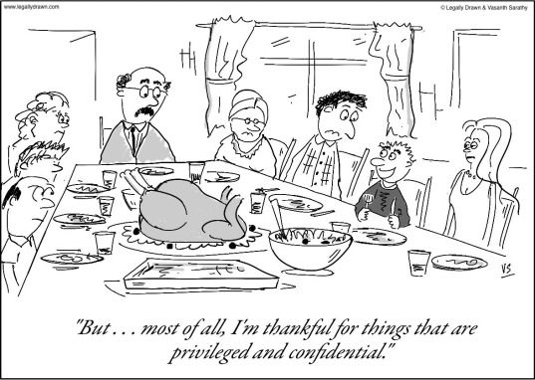
Confidentiality at Mediation
Policy Considerations
Exclusion or Privilege
Confidentiality Agreements
Duties to Disclose
Current Legal Parameters
Notes:
General Policy Considerations
Trust—parties in a dispute inherently distrust each other. Such distrust, however, is a barrier to settlement. Confidentiality creates an environment that even if you don’t establish trust, a party can be assured that what they say won’t be used against them.
FRE 408: Exclusionary rule on compromise agreements—part of rules of evidence which encourages settlement outside of mediation.
essentially prohibits the use of settlement offers as evidence of liability in a trial of a lawsuit.
Includes: offers to compromise, settlement agreements.
TRE 408
Confidentiality as protection of the mediator—may have an ongoing role within the mediation so maintains neutrality; confidentiality serves to limit the mediator’s involvement in the continuation of the cases and to maintain impartiality.
Problems—Exploitation of confidentiality:
Misuse of the mediation process to delay trial, misrepresentation of facts to manipulate a favorable outcome; Refusal to participate even though attend;
Misrepresentations—a party may rely on that misrepresentation but would have no recourse b/c of the confidential nature of the setting;
No check on mediator’s conduct b/c everything is confidential;
Contrary to public policy/need for information—court will apply balancing test to determine.
cases involving government wrongdoing, the environment
Duty to report child abuse
Threats of physical harm
Disclosure to seek advice.
Exclusion or Privilege
Where a statute provides for confidentiality in mediation, the courts will generally uphold it.
An Exclusion - Scope and Limits (dealing with in court litigated matters)
Exclusion pertains to admissibility of evidence.
FRE 408/TRE 408 on compromise negotiations can’t be used as evidence in a trial.
Exclusion does prohibit all parties from testifying—regardless of whose testimony is sought: mediator, attorney, or a party.
A Privilege.
Provides a broader scope of confidentiality than exclusion.
A privilege involves parties in a relationship and generally prohibit the disclosure by one party of information revealed by the other.
May include files and records of a mediation program.
When mediator claims a disputant-mediator privilege, the courts employ the Wigmore test—privilege exists if:
Communication originated in confidence
Confidentiality essential to the full and satisfactory maintenance of the relationship of the parties;
The community values the confidentiality of the relationship;
The injury of disclosure is greater than the benefit.
Balancing the need for certain information versus protection of confidences and hence the mediation process
EXCEPTION to Privilege of Mediator:
Texas Family Code 261.101—requires you to report child abuse/neglect.
Both mediator and attorney have the responsibility to report this.
Confidentiality Agreements
Two types of Confidentiality:
Confidential process to the rest of the world (privilege)
Confidential between caucus/ parties (except for what authorized to take out)
The rest of the mediation is not confidential b/c it has to be put in writing and filed with court—settlement agreement.
Agreements:
Enforceability likely unless there is an overriding need for the information;
Can people construct CAs in regards to need?
Pre-litigation courts generally uphold agreements If testimony can be compelled probably not uphold
Deterrence
Once disclosure occurs, the harm’s done.
Breach of agreement COA
Court Orders
Should include a reasonable justification.
Discovery Considerations
Matters discussed in mediation are subsequently discoverable if they would have been discoverable otherwise.
Duties to Disclose
There is no duty of the mediator greater than the duty to preserve the confidentiality of everything revealed to him during the hearing.
Absolute duty to disclose (some believe) in few instances (testify in court)
Criminal D needs as part of defense
Report child abuse
Possible exceptions:
California - custody cases and court needs information regarding the mediation;
Florida - criminal defendant needs the information for a defense;
Child abuse - in camera
Mediator suspects wrongdoing;
Current Legal Parameters
Generally
There is a mediator privilege in TX; complete exclusion of mediator testimony is necessary to the preservation of an effective system of mediation. NLRB v Macaluso: “While the law is entitled to every person’s evidence, where the public is more greatly benefit from the privilege than not, the privilege exists.”
Evidentiary exclusions.
Mediator does not have to testify in court where a statute or rule to the contrary exists.
FRE 408 not strictly construed b/c then only offers limited protection. United States v. Gullo “Even though there is a strong policy favoring the full development of the facts in a criminal case, the purpose of confidentiality serves to encourage participation in the program. Absent a particular need, the information should continue to be confidential.”
Confidentiality extends to all oral or written agreements unless all parties agree to their disclosure. Hudson v. Hudson
A mediation communication is confidential and can’t be disclosed by anyone. Schneider v. Kreiner A form completed by the mediator after the mediation is a “communication” within the act b/c it’s basically the mediator’s work product. The law provides for compelled disclosure where the parties consent or a court orders it to prevent manifest injustice but the possibility of future litigation doesn’t establish the presence of a manifest injustice.
Mediation Privileges
Absolute privilege which prevents the mediator from discussing the matter with anyone is what most people expect
A survey of the statutes does not reveal support for an absolute privilege
The only clear waiver, not judicially tested, may be in terms of allowing the mediator to testify in his own defense in a malpractice case.

Slide 13
Where can I find “the law” on ADR?
ADR Act – enacted 1987
Found in Texas Civil Practice and Remedies Code Chapter 154
Covers:
  Procedures (Sec. 154.021-154.028)
  Role/Qualifications of Impartial third parties (Sec. 154.051-154.053)
  Compensation of Impartial Third Parties (Sec. 154.054)
  Qualified Immunity (Sec. 154.055)
  Effect of Written Settlement Agreements (Sec. 154.071)
  Confidentiality of Records and Communications (Sec. 154.073)

Slide 14
Final Tips for Attending Mediation
Be prepared to negotiate
Be open minded
Be prepared for varied mediator styles
Consider the “big picture” factors
Notes:
Be prepared to negotiate – no one leaves 100% happy
Be open minded – in mediation training they teach “expanding the pie,” so anticipate out of the box suggestions
Be prepared for varied mediator styles – each mediator is different in style and involvement in the mediation itself based on both their experience (some are former judges) and personality
Consider the “big picture” – remember the why of the reason you’re there, you’re ultimate goals, and the potential risk of not settling

Slide 15
Questions
ebrown@olsonllp.com
713-533-3800
Notes:
Put in contact info

