Slide 1
Effects of the Legalization of Marijuana in the Workplace
Local Government Seminar
January 29, 2015
Presented by:
Karen Singer & Loren B. Smith

Slide 2
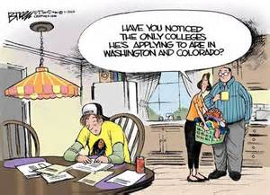
Colorado and Washington
Effective January 1, 2014, the State of Colorado, through a constitutional amendment, approved by the voters of the state decriminalized the possession and use of marijuana for personal use.
Through Initiative 502, by a 56% to 44% vote, voters in the State of Washington approved a similar change to the regulation of marijuana for personal use.

Slide 3
How Long Does Marijuana Stay in the Human Body?
Different studies indicate that marijuana in the human body can be detected for various lengths of time.
United Patients Group indicates that a single use of marijuana can be detected by a urine test up to 7 days after the use.
The same group indicates that regular use of marijuana can be detected by a urine test up to 100 days after the last use.

Slide 4
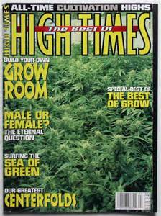
How Long Does Marijuana
Stay in the Human Body?
High Times Magazine suggests that a marijuana user who is going to be subjected to a urine test cease using marijuana 3 months prior to the test.

Slide 5
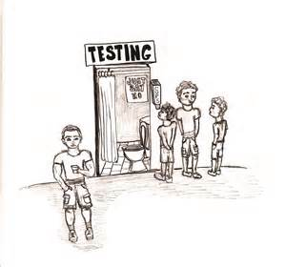
What Effect Does the Legalization of Marijuana Have on Employers?
Assume you have an employee or applicant who tests positive for marijuana.
The same employee or applicant tells you that he was recently in Colorado and smoked some marijuana while there.
Assume also that the employee or applicant produces a copy of a plane ticket demonstrating his travel to Colorado.

Slide 6
What Effect Does the Legalization of Marijuana Have on Employers?
None.
Subsection 6 (a) of Colorado Amendment 64 states:
  “Nothing in this section is intended to require an employer to permit or accommodate the use, consumption, possession, transfer, display, transportation, sale or growing of marijuana in the workplace or to affect the ability of employers to have policies restricting the use of marijuana by employees.”

Slide 7

What Effect Does the Legalization of Marijuana Have on Employers?
Washington’s marijuana law contains a similar provision.
Employers have the right to determine regulate its employees’ conduct.
The right to regulate its employees’ conduct extends even to conduct outside the workplace.

Slide 8
MD Anderson
In fact, the University of Texas MD Anderson Cancer Center adopted a tobacco-free hiring policy effective January 1, 2015.
Under the policy, all applicants will be screened for tobacco use.
Applicants who test positive will not be eligible for immediate employment.
If interested, they will be given tobacco-cessation materials and instructions for obtaining assistance and will be permitted to reapply in 180 days.

Slide 9
What Effect Does the Legalization of Marijuana Have on Employers?
These policies are being challenged, and from some very interesting people.
Pete Holmes, the City Attorney for the City of Seattle, Washington was photographed second in line to purchase marijuana on the day it became legal.
Mr. Holmes is seeking to have the City of Seattle’s policies changed to treat possession and use of marijuana in the same manner as alcohol.

Slide 10
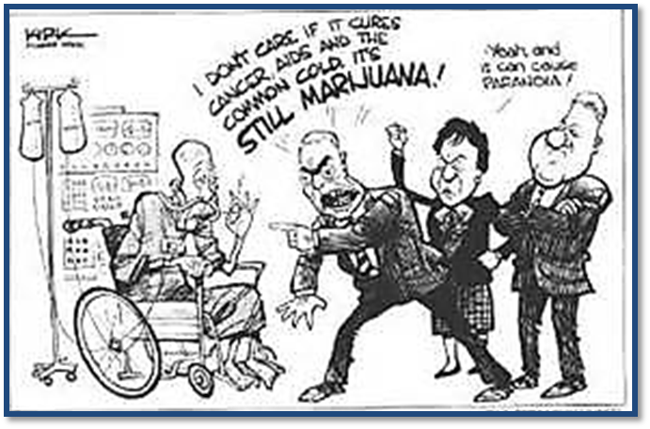
What About Marijuana Use for Medicinal Purpose?
Texas does not permit marijuana use for medicinal uses, so the answer is essentially the same.
Even in the State of Washington which does allow medical marijuana use, employers are not required to make an accommodation for the medical use of marijuana if the employer has established a drug-free workplace.

Slide 11
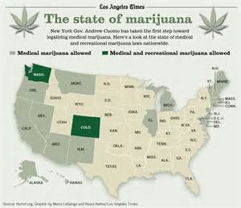
Stay Tuned
As you can imagine, this is an area of the law across the nation that is in a state of flux.
There are currently two lawsuits, one before the Colorado Supreme Court and one before the United States Court of Appeals for the Sixth Circuit involving a case out of Michigan, challenging employers’ drug-free workplace policies for medical marijuana.

Slide 12

Bottom Line
In Texas, employers are still permitted to implement drug-free workplace policies and to enforce those policies through tests in accordance with adopted policies.

