Slide 1
Managing Through Personal Crisis
Local Government Seminar
January 29, 2015
Presented by:
Julie M. Robinson, City Administrator, City of Dickinson

Slide 2
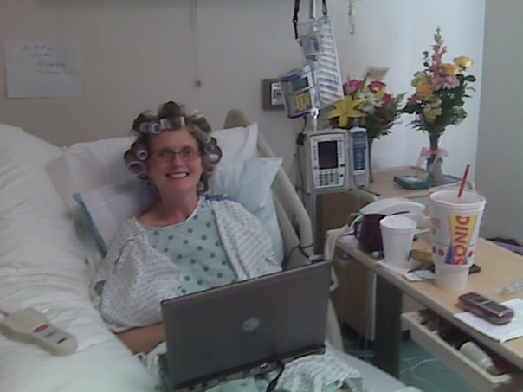
So What Does Managing Through Personal Crisis Look Like?

Slide 3
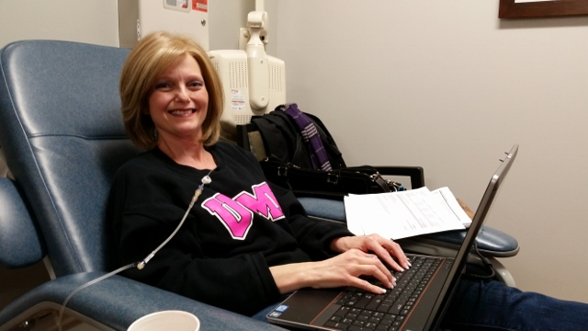
So What Does Managing Through Personal Crisis Look Like?

Slide 4
My Personal Crisis
2004:
  Stage 1 aggressive breast cancer diagnosis
  4 surgeries AND 4 rounds of chemotherapy in 7 months
2009:
  Rediagnosed with metastatic breast cancer
  Emergency hospitalization (unable to walk)
  Corpectomy procedure required back brace

Slide 5

How Have I Continued to
Manage My City?
Managing 2 cities during this 11-year battle requires:
  Organization and planning
  Communication, Communication, Communication

Slide 6

How Have I Continued to
Manage My Personal Life?
My support group – my amazing husband Jim, Mother-In-Law Extraordinaire Joyce, my own family and friends
My medical team
Let go and let God
There is a purpose behind all of this – I reach out to others dealing with cancer of all kinds and help

Slide 7
How Have I Continued to
Manage My Personal Life?
Take care of myself
Remember to be patient with my body
Roll with the punches & remember what is important
Do not give it any energy – maintain normalcy to the greatest extent possible

Slide 8
Suggestions
Let the bad news sink in
Accept what you can’t change/control –
work on what you can control
Manage the mind-body connection
Focus on faith and positive thoughts

Slide 9

Final Thoughts
“Crisis takes us to the brink of our limits and forces us to keep moving forward.”
- When You’re Falling, Dive: Lessons in the At of Living, Mark Matousek

Slide 10
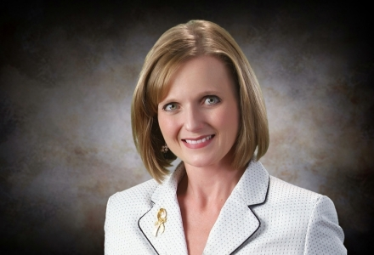
Questions?
Julie M. Robinson
Office: (281) 337-6204
Email: jrobinson@ci.dickinson.tx.us

