Slide 1
Dealing With The Client You Can’t Fire
Local Government Seminar
January 29, 2015
Presented by:
Arthur (“Art”) Pertile, III
Partner

Slide 2

DEALING WITH THE CLIENT
YOU CAN’T FIRE
WHO IS MY DADDY?

Slide 3
DEALING WITH THE CLIENT
YOU CAN’T FIRE
Mayor
Councilmembers
Board Members
Managers
Employees
    Police Officers
    Firefighters
    Garbage truck drivers

Slide 4
DEALING WITH THE CLIENT
YOU CAN’T FIRE
A lawyer employed or retained by a governmental entity represents the entity.
Texas Disciplinary Rule of Professional Conduct, Section 1.12(a)

Slide 5
DEALING WITH THE CLIENT
YOU CAN’T FIRE
  Olsonville and the Town of Olson form a Local Government Corporation named “Non Compos Mentis” to provide governmental services to both cities with the governing body appointed by both cities.
  The City Attorney for Olsonville is named General Counsel for “Non Compos Mentis.”
  A matter comes before the “Non Compos Mentis” board that is good for “Non Compos Mentis,” but will have a negative effect on Olsonville.

Slide 6
DEALING WITH THE CLIENT
YOU CAN’T FIRE
A lawyer employed or retained by a governmental entity represents the entity.
Texas Disciplinary Rule of Professional Conduct, Section 1.12(a); Ethics Committee Opinion 633

Slide 7
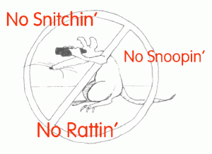
DEALING WITH THE CLIENT
YOU CAN’T FIRE
I AIN’T NO SNITCH!

Slide 8
DEALING WITH THE CLIENT
YOU CAN’T FIRE
  A lawyer representing a governmental entity must take reasonable remedial actions whenever the lawyer learns or knows that:

Slide 9
DEALING WITH THE CLIENT
YOU CAN’T FIRE
  (1) an officer, employee, or other person associated with the entity has committed or intends to commit a violation of a legal obligation to the entity or a violation of law which reasonably might be imputed to the entity;
  (2) the violation is likely to result in substantial injury to the entity; and
  (3) the violation is related to a matter within the scope of the lawyer’s representation of the entity.
Texas Disciplinary Rule of Professional Conduct, Section 1.12(b)

Slide 10

DEALING WITH THE CLIENT
YOU CAN’T FIRE
HEADS:
I AM A COUNCILMEMBER
TAILS:
I AM A CRIMINAL DEFENSE LAWYER

Slide 11
DEALING WITH THE CLIENT
YOU CAN’T FIRE
Attorney serves as a City Councilmember of Olsonville.
Attorney represents criminal defendants in Olsonville.
City Council hires the City Manager that supervises the police department.

Slide 12
DEALING WITH THE CLIENT
YOU CAN’T FIRE
The City Council sets the police department budget.
Olsonville police officers are witnesses for the prosecution in criminal cases.

Slide 13
DEALING WITH THE CLIENT
YOU CAN’T FIRE
Attorney is prohibited from representing criminal defendants in criminal courts in Olsonville unless his clients and the City Council of Olsonville consent to the representation. Also applies to Municipal Court Judges.
Texas Disciplinary Rule of Professional Conduct, Sections 1.06(b)(2) and 1.06(c)2; Ethics Committee Opinion 497
Texas Disciplinary Rule of Professional Conduct, Sections 1.11(a) and 1.06(c); Ethics Committee Opinion 541

Slide 14

DEALING WITH THE CLIENT
YOU CAN’T FIRE
DID I JUST SHOOT MYSELF
IN THE FOOT?

Slide 15
DEALING WITH THE CLIENT
YOU CAN’T FIRE
  Ethics Board ordinance creates board to investigate and review complaints against City officials and employees.
  The City Attorney represents Ethics Board.

Slide 16
DEALING WITH THE CLIENT
YOU CAN’T FIRE
  The City Attorney is hired and compensation is set by the City Council.
  A Citizen files an ethics complaint against 5 of the 7 City Councilmembers.

Slide 17
DEALING WITH THE CLIENT
YOU CAN’T FIRE
  The City Attorney cannot represent the Ethics Board in the investigation of a majority of the City Councilmembers.
  City Attorney’s interest (in remaining as City Attorney), and the City’s interest, are adverse.
  Texas Disciplinary Rule of Professional Conduct, Section 1.06(b)(2); Ethics Committee Opinion 567

Slide 18
DEALING WITH THE CLIENT
YOU CAN’T FIRE
The City Attorney should not ask for City Council’s consent to represent the Ethics Board because of the inherent conflict between said Board’s responsibility and the City Attorney’s personal employment interests.
Texas Disciplinary Rule of Professional Conduct, Section 1.06(c)(1); Ethics Committee Opinion 567

Slide 19

DEALING WITH THE CLIENT
YOU CAN’T FIRE
PAY BACK IS A ____!

Slide 20
DEALING WITH THE CLIENT
YOU CAN’T FIRE
  Lawyer, a former attorney in the City Attorney’s office, was forced to resign last year.
  Lawyer represents a Client before a City Board in a matter unrelated to any areas she handled with the City.
  City’s Ethics Ordinance prohibits former City employees from appearing before a City Board or Commission for two years after their resignation, unless on behalf of a relative.

Slide 21
DEALING WITH THE CLIENT
YOU CAN’T FIRE
The City’s Ethics Board ordinance prohibits the lawyer from appearing before the Board because the prohibition applies to all former employees, not just lawyers.
Texas Disciplinary Rule of Professional Conduct, Section 5.06; Ethics Committee Opinion 551

Slide 22
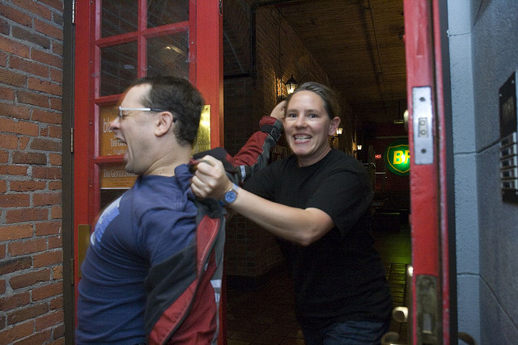
DEALING WITH THE CLIENT
YOU CAN’T FIRE
YOU DO NOT HAVE TO GO HOME, BUT YOU HAVE TO GET OUT OF HERE!

Slide 23
DEALING WITH THE CLIENT
YOU CAN’T FIRE
  Lawyer is a member of the Olsonville City Council.
  Lawyer’s law partner has filed a lawsuit against Olsonville.
  Olsonville is holding an executive session to discuss the lawsuit.

Slide 24
DEALING WITH THE CLIENT
YOU CAN’T FIRE
Lawyer demands that he be allowed to attend the executive session when the lawsuit is being discussed.

Slide 25

DEALING WITH THE CLIENT
YOU CAN’T FIRE
City Council may invoke its attorney-client privilege and exclude Lawyer from the Executive Session regarding the litigation.
Texas Attorney General Opinion JM-1004

Slide 26

DEALING WITH THE CLIENT
YOU CAN’T FIRE
I AM A CITIZEN AND THEY ARE MY COUNCILMEMBERS!

Slide 27
DEALING WITH THE CLIENT
YOU CAN’T FIRE
  Lawyer sues Olsonville.
  Olsonville has tendered a settlement offer through its City Attorney.
  Lawyer calls Olsonville City Councilmembers to complain about the low settlement offer.

Slide 28
DEALING WITH THE CLIENT
YOU CAN’T FIRE
  City Attorney requests that Lawyer not contact City Councilmembers regarding the litigation.

Slide 29
DEALING WITH THE CLIENT
YOU CAN’T FIRE
  Lawyer is prohibited from communicating with City Councilmembers regarding the litigation.
  Texas Disciplinary Rule of Professional Conduct, Section 4.02; Ethics Committee Opinion 474

Slide 30

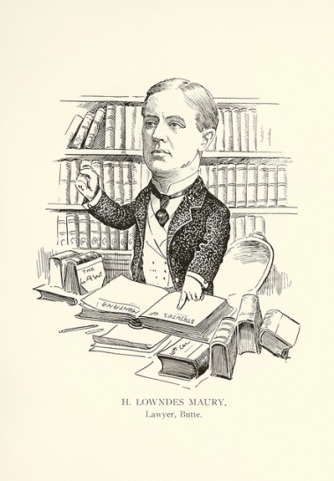
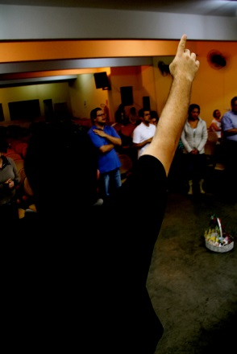
DEALING WITH THE CLIENT
YOU CAN’T FIRE
IF I COULD JUST CONFLICT OUT ALL THE LAWYERS IN TOWN, MY JOB WOULD BE SO MUCH EASIER!

Slide 31
DEALING WITH THE CLIENT
YOU CAN’T FIRE
  Lawsuit is threatened against City of Olsonville.
  Olsonville is small city with limited number of lawyers.
  City Attorney proposes to Olsonville City Council a plan to retain all lawyers within the City so that there are no lawyers in town to sue City.

Slide 32
DEALING WITH THE CLIENT
YOU CAN’T FIRE
  A City Attorney is prohibited from retaining all available local lawyers in order to prohibit opposition from hiring a local lawyer.
  Texas Disciplinary Rule of Professional Conduct, Section 4.04; Ethics Committee Opinion 585

Slide 33

DEALING WITH THE CLIENT
YOU CAN’T FIRE
  WE ARE GOING TO SUE YOU AND YOU CAN’T HIRE OUR FORMER LAWYERS!

Slide 34
DEALING WITH THE CLIENT
YOU CAN’T FIRE
  Olsonville and the Village of Olson are threatening to sue each other.
  Olsonville hires Best, Ng, Townes, LLP.
  Best, Ng, Townes, LLP. previously performed work for the Village of Olson unrelated to the current dispute.

Slide 35
DEALING WITH THE CLIENT
YOU CAN’T FIRE
  No lawyers for Best, Ng, Townes, LLP., that performed any work for the Village of Olson, will be working on the current controversy.
Best, Ng, Townes, LLP. asks the Village of Olson to consent to its the representation of Olsonville.

Slide 36
DEALING WITH THE CLIENT
YOU CAN’T FIRE
  Without prior consent, a lawyer who personally has formerly represented a client in a matter shall not, thereafter, represent another person in a matter adverse to his former client:
    (1) in which such other person questions the validity of the lawyer’s services or work product for the former client;
    (2) if the representation in reasonable probability will involve a violation of Rule 1.05; or
    (3) if it is the same or a substantially related matter.

Slide 37
DEALING WITH THE CLIENT
YOU CAN’T FIRE
  Best, Ng, Townes, LLP., may represent Olsonville in its dispute with the Village of Olson.
        Texas Disciplinary Rule of Professional Conduct, Sections 1.09(a); Ethics Committee Opinion 578

Slide 38

DEALING WITH THE CLIENT
YOU CAN’T FIRE
I MADE A PROMISE TO THE PEOPLE AND, BY GOD, I WILL DELIVER!

Slide 39

DEALING WITH THE CLIENT
YOU CAN’T FIRE
"I, ____________, do solemnly swear that I have not directly or indirectly paid, offered, promised to pay, contributed, or promised to contribute any money or thing of value, or promised any public office or employment for the giving or withholding of a vote at the election at which I was elected or as a reward to secure my appointment or confirmation, whichever the case may be, so help me God.”
        Article 16 Section 1(b) Texas Constitution

Slide 40
Dealing With The Client You Can’t Fire
Local Government Seminar
January 29, 2015
Presented by:
Arthur (“Art”) Pertile, III
Partner

