Slide 1

Recycling Programs
Single Entity vs Cooperative Strategies

Slide 2

Adrian Hernandez, M.S.
Executive Director, Keep Pearland Beautiful
Councilmember Position 4, City of Pearland, TX
Chair, H-GAC Solid Waste Management Committee
Chair, NLC First-Tier Suburbs Council
2nd Vice-President, Brazoria County Cities Association
Board Member, NLC Energy, Environment & Natural Resources Committee
Member, H-GAC Coastal Communities Water Quality Outreach Project Team
Member, WaterNow Alliance
Member, State of Texas Alliance for Recycling

Slide 3
Keep Pearland Beautiful
Founded in 1982 as Clean Pearland
Affiliate of Keep Texas Beautiful and Keep America Beautiful
Assumed operation of the Stella Roberts Recycling Center in 2016
Processes ~5,000 Drive-Thru Vehicles per Month
Serves ~30 Cities in 4 Counties
Accepts Wide Array of Catergories
  OCC, Paper, Plastic
  Glass, Lightbulbs
  Batteries, Oil, Paint (Latex & Water), Antifreeze, and other HHW Chemicals
  Electronics, Metals, Appliances

Slide 4
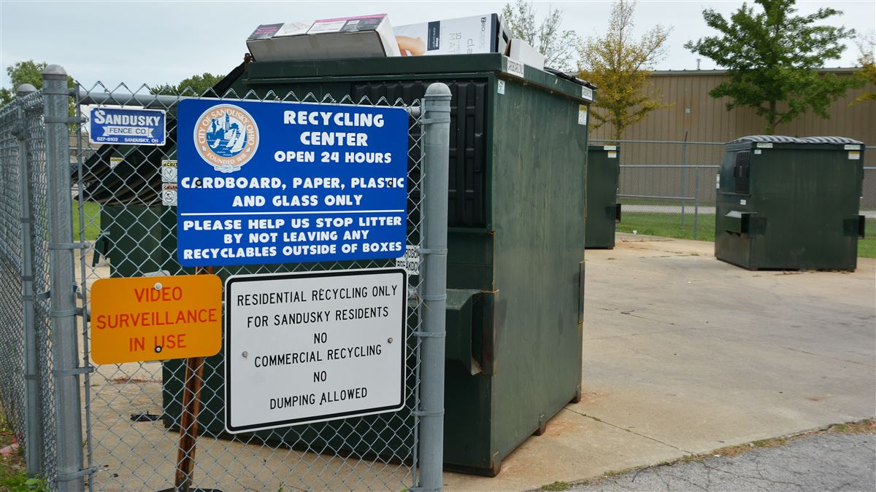
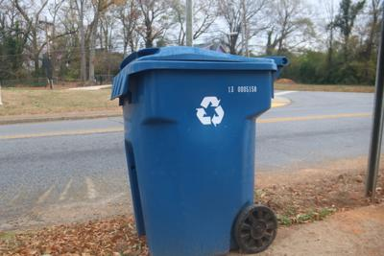
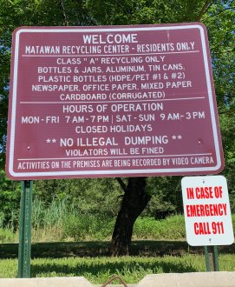
Single Entity Strategies

Slide 5
Single Entity Strategies
Curbside Recycling
Consistent access for all residents.
Opportunity to educate upon delivery.
Industry expertise to drive program design, execution, and reporting.
Costly to deploy and maintain if no billing/utility infrastructure currently exists.
Presents potential for contamination if education is not handled properly.
Resident-Only Drop Off
Allows for better sorting of materials to reduce contamination.
Less costly to deploy and maintain single-site strategy.
Opportunity to educate with each visit utilizing signage and other interactive installations on-site.
Inconsistent/inconvenience access for some residents.
May present potential for illegal dumping activity and require enforcement.

Slide 6
Single Entity Strategies
Resident-Only Staffed Facility
Allows for best practices of sorting and handling materials.
Allows for acceptance of additional materials beyond typical ST programs.
Allows for on-site education with each visit.
Provides greatest opportunity to reduce contamination.
Inconsistent/inconvenient access for some residents.
Costly to deploy and maintain program depending on staff requirements.
Consider working with local ‘Keep Beautiful’ or environmental volunteers to assist.

Slide 7
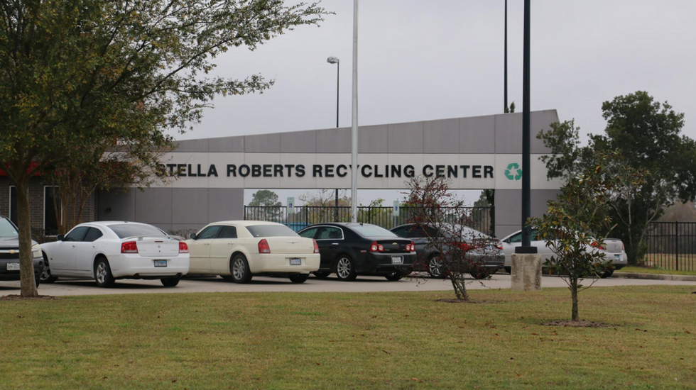
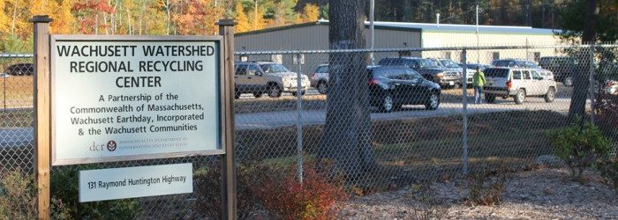
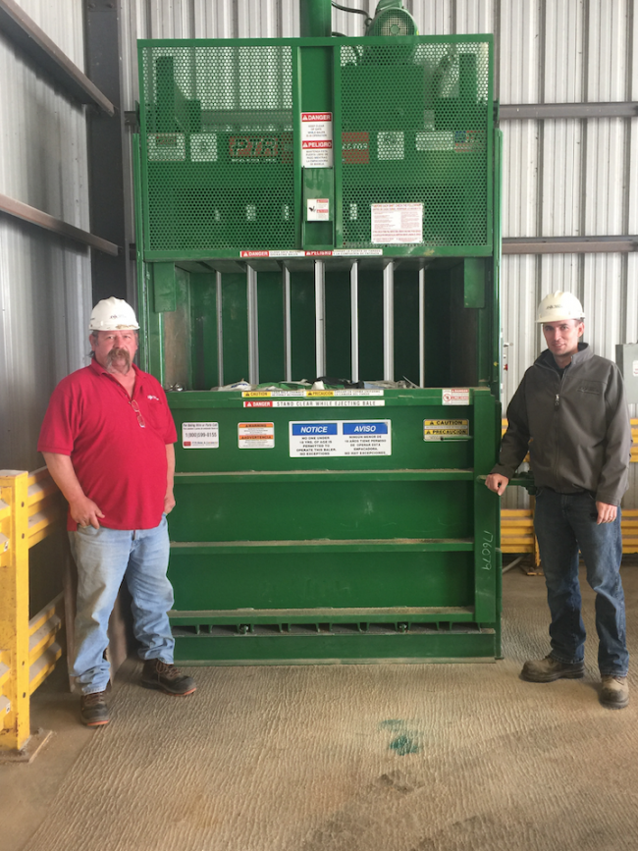
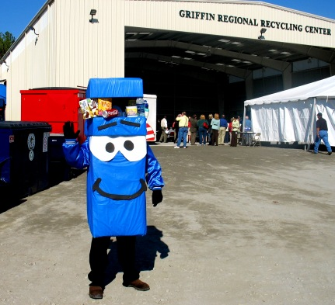
Cooperative Strategies

Slide 8
Cooperative Strategies
Curbside
Drop-Off Site
Staffed Facility
Advantages of regional or cooperative strategies:
Reduce cost concerns for smaller entities.
Increased access for rural areas.
Consistent marketing and education for larger region.
Consistent strategies to address contamination concerns.
Broad representation of expertise to design and maintain program(s).

Slide 9
Cooperative Strategies
Things to consider
May have to negotiate/re-negotiate individual MSW contracts.
Reporting and metrics need to be standardized for funding requests.
Consider cooperating with local civic groups or nonprofits.
Location of drop-off sites or centers to largest population centers.
Ability to expand operations as regional demand grows.

Slide 10
Program Considerations
Cost
Potential
Contamination
Accessibility

Slide 11
Resources
H-GAC or Texas Association of Regional Councils (TARC)
- H-GAC Solid Waste Management Committee
State of Texas Alliance for Recycling (STAR)
Keep Texas Beautiful / Keep America Beautiful
Industry Partners and Existing Facilities

Slide 12
Questions?
Contact Me
Adrian Hernandez, M.S.
5800 Magnolia Pkwy
Pearland, TX 77584
(281) 489-2795
adrian@mykpb.org

